Slide 1
In LAC, from 2006 through 2014, fewer people ages 12 and over perceived smoking marijuana once a month harmful (decreased from 40% in 2006-2008 to 29% in 2012-2014). At the same time, current use increased from 6% in 2006-2008 to 8% in 2012-2014.
NATIONAL SURVEY ON DRUG USE AND HEALTH (NSDUH). AVAILABLE AT HTTPS://WWW.SAMHSA.GOV/DATA/POPULATION-DATA-NSDUH/REPORTS?TAB=38 & HTTPS://ARCHIVE.SAMHSA.GOV/DATA/NSDUH.ASPX

Slide 2
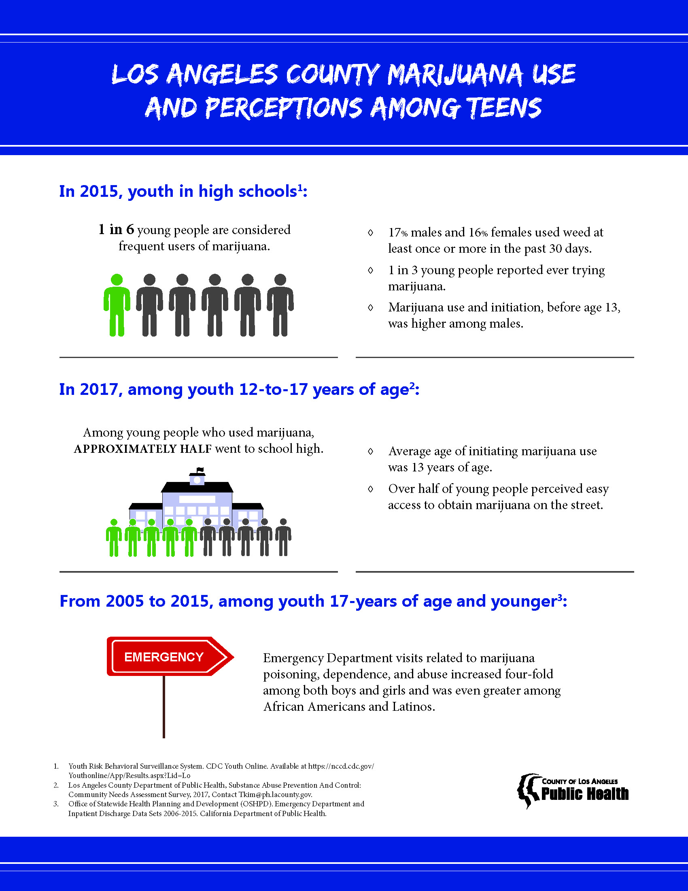
Youth Risk Behavioral Surveillance System. CDC Youth Online. Available at https://nccd.cdc.gov/Youthonline/App/Results.aspx?Lid=Lo

Slide 3
LA County High School Students in 2015
17% males and 16% females used weed at least once or more in the past 30 days.
About 1 in 3 young people reported ever trying marijuana.
Marijuana use and initiation, before age 13, was higher among males.
YOUTH RISK BEHAVIORAL SURVEILLANCE SYSTEM. CDC YOUTH ONLINE. AVAILABLE AT HTTPS://NCCD.CDC.GOV/YOUTHONLINE/APP/RESULTS.ASPX?LID=LO

Slide 4
Emergency Department visits related to marijuana poisoning, dependence, and abuse increased four-fold among both boys and girls and was even greater among African Americans and Latinos.
OFFICE OF STATEWIDE HEALTH PLANNING AND DEVELOPMENT (OSHPD). EMERGENCY DEPARTMENT AND INPATIENT DISCHARGE DATA SETS 2006-2015. CALIFORNIA DEPARTMENT OF PUBLIC HEALTH.

Slide 5
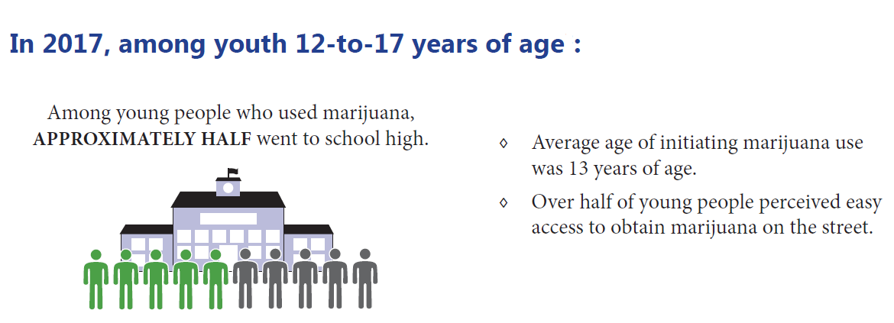
LOS ANGELES COUNTY DEPARTMENT OF PUBLIC HEALTH, SUBSTANCE ABUSE PREVENTION AND CONTROL: COMMUNITY NEEDS ASSESSMENT SURVEY, 2017, CONTACT TKIM@PH.LACOUNTY.GOV.

