Slide 1
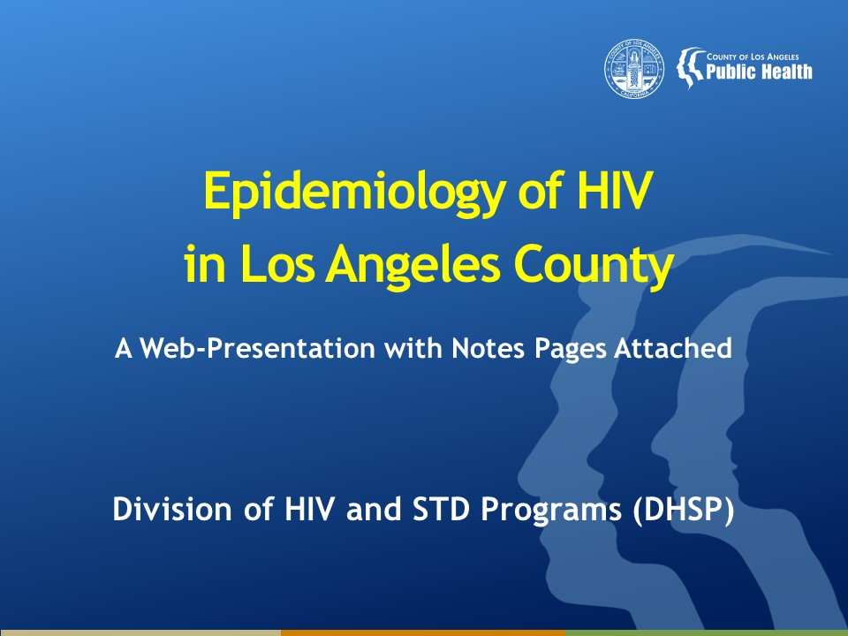
Epidemiology of HIV in Los Angeles County
A Web-Presentation with Notes Pages Attached
Division of HIV and STD Programs (DHSP)
Notes:
This presentation is intended to provide a general overview of the epidemiology of Human Immunodeficiency Virus (HIV) Disease in Los Angeles County (LAC).
Data are provided by the Division of HIV and STD Programs (DHSP) located at 600 South Commonwealth Avenue, Suite 1260, Los Angeles, CA 90005.
Notes are provided for each slide, intending to provide proper interpretation of the data presented on the slides.
Please note that data for years 2020 through 2021 are provisional due to reporting delays.

Slide 2
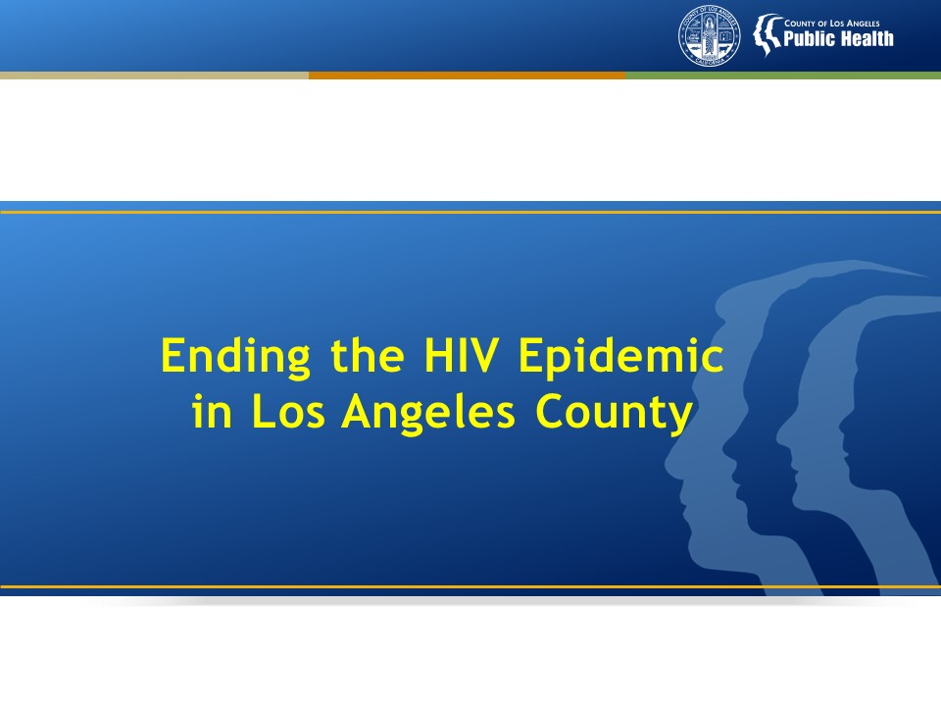
Notes:
Ending the HIV Epidemic in the US (EHE) is a federal plan, launched in 2020, that aims to reduce new HIV infections in the US by 75% by 2025 and by 90% by 2030. In February 2020, the US Department of Health and Human Services awarded 57 high burden states and counties, inclusive of LAC, with hundreds of millions of dollars to expand HIV prevention and care activities to accelerate progress towards achieving the national EHE goals.
Ending the HIV Epidemic in LAC focuses on four key pillars of diagnosing, preventing, treating, and responding to HIV. Within these pillars, LAC Public Health is committed to a local response that is high quality and rapidly deployed, prioritizing the highest impact interventions to optimize performance along the steps of the HIV care continuum, and using local evidence at the most granular level possible to identify where and among whom HIV is transmitted so that we can then target interventions to where they are needed most.

Slide 3
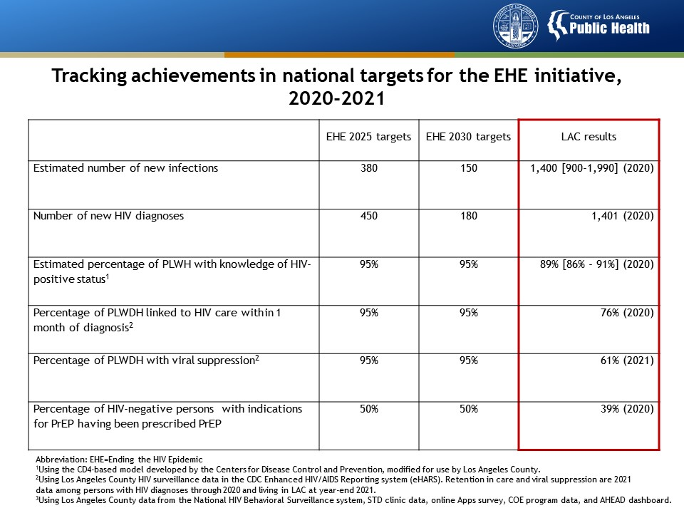
Notes:
This table presents the key metrics that are being tracked to measure progress towards targets in the EHE initiative and progress to date in LAC.

Slide 4
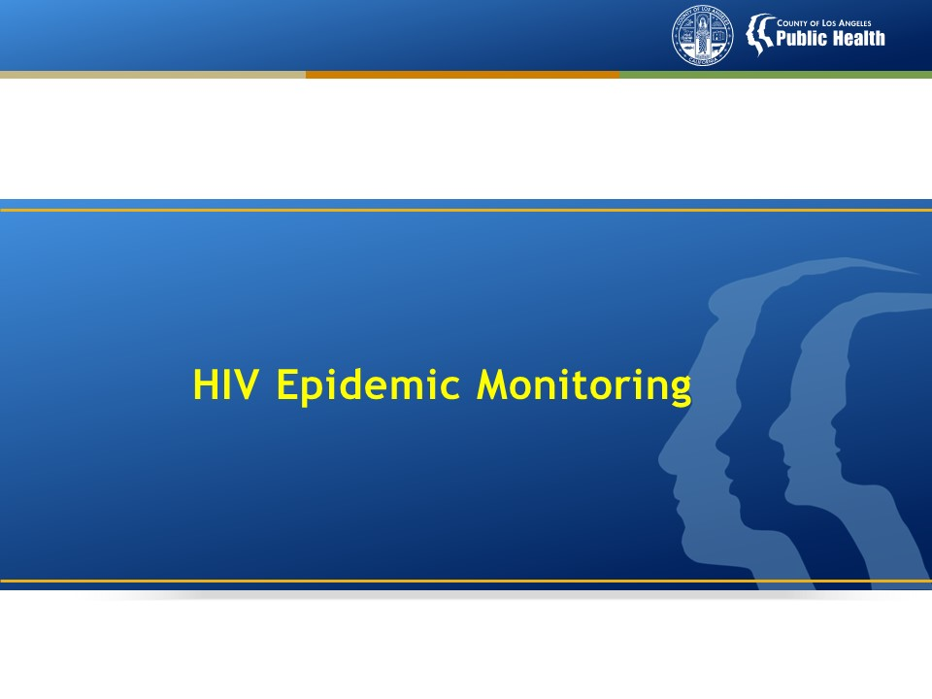

Slide 5
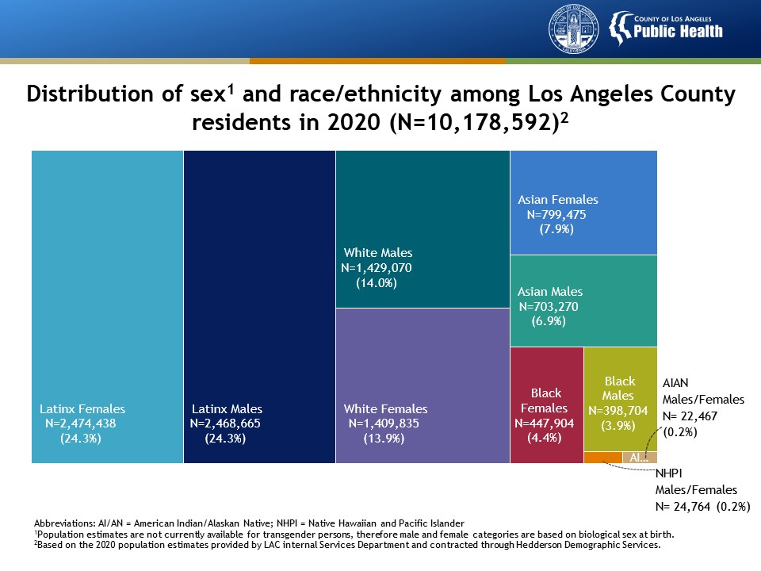
Notes:
This slide presents the distribution of sex and race/ethnicity among Los Angeles County (LAC) residents in 2020. An estimated 10.2 million people resided in LAC in 2020. The Latinx population represented the largest population group (49%), followed by White (28%), Asian (15%), and Black populations (8%). Native Hawaiians and Pacific Islanders (NHPI) and American Indians and Alaska Natives (AIAN) represented less than 1% of the total LAC population and were presented for males and females combined due to limited visibility on the graph. Population estimates for multi-racial persons are not available.
Population estimates are not currently available for transgender persons, therefore male and female categories are based on biological sex at birth.
Data are based on the 2020 population estimates provided by LAC internal Services Department and contracted through Hedderson Demographic Services.

Slide 6
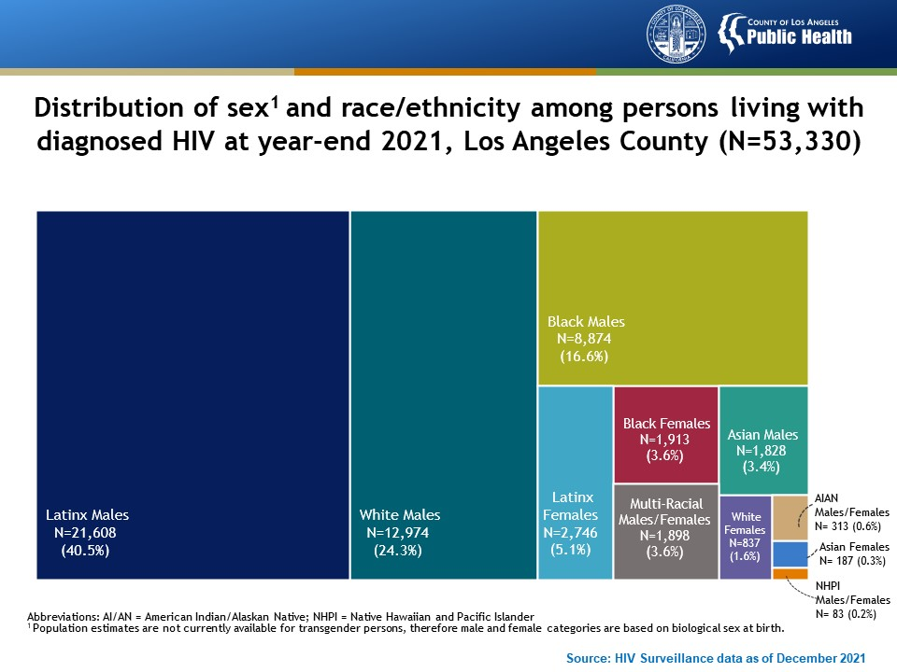
Notes:
This slide presents the distribution of sex and race/ethnicity among persons living with diagnosed HIV (PLWDH) in Los Angeles County at year-end 2021. In contrast to the distribution of the total residents in Los Angeles County, the populations most impacted by the HIV epidemic were Latinx males who represented 41% of all PLWDH followed by White males (24%) and Black males (17%). Combined, these groups of men represent over 80% of PLWDH in LAC. Altogether, AIAN, NHPI, and multi-racial men and women represented less than 5% of PLWDH in LAC. PLWDH with unknown race/ethnicity were not presented in the graph (n=69).
Population estimates are not currently available for transgender persons, therefore male and female categories are based on biological sex at birth.

Slide 7
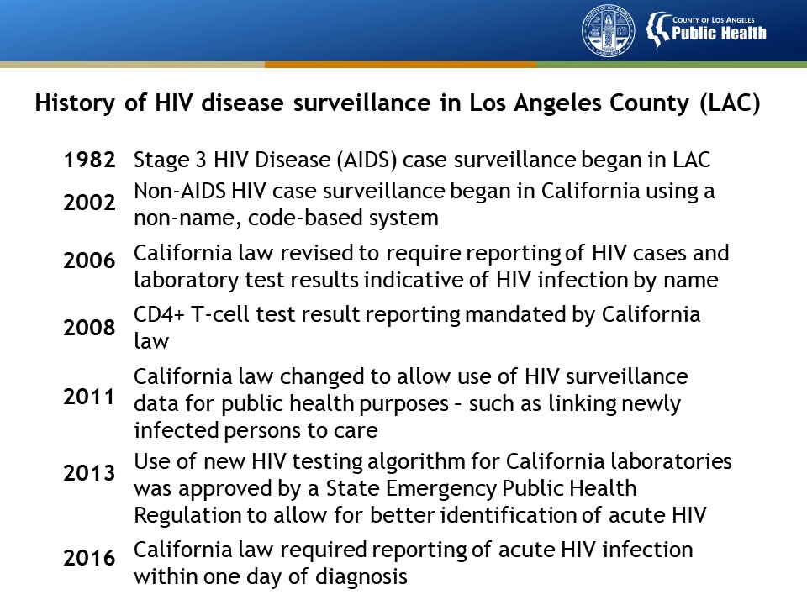

Slide 8
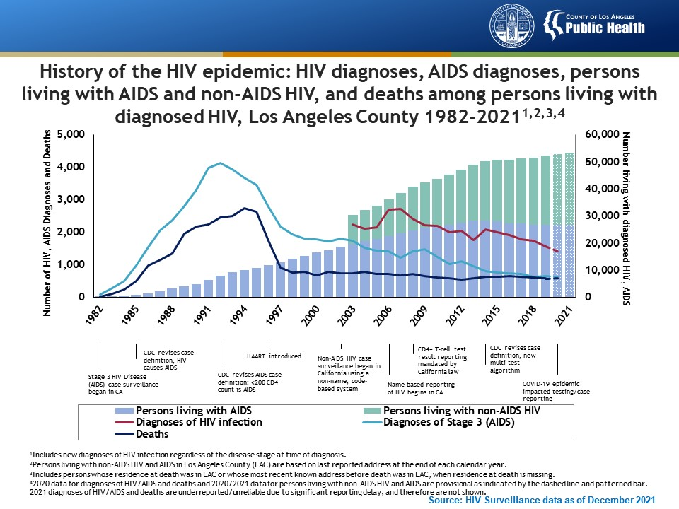
Notes:
This graph presents the number of HIV/AIDS diagnoses, persons living with AIDS and non-AIDS HIV, and deaths among persons living with diagnosed HIV in Los Angeles County (LAC) from 1982 to 2021. In LAC, AIDS reporting began in 1982 and the annual number of cases peaked in 1992 with more than 4,000 cases reported that year. In 1994, deaths reached an all-time high followed by a significant decline that coincided with the introduction of highly active antiretroviral treatment (HAART) for HIV in 1996. In 2006, name-based HIV reporting began in California, allowing for better tracking of trends in diagnosed HIV irrespective of disease stage. HIV epidemic trends thereafter have declined for diagnosed HIV and deaths. Note the number of deaths among PLWDH increased slightly between 2019 and 2020.
Diagnoses of HIV infection include new diagnoses of HIV infection regardless of the disease stage at time of diagnosis.
Persons living with non-AIDS HIV and AIDS in LAC are based on last reported address at the end of each calendar year.
Deaths include persons whose residence at death was in LAC or whose most recent known address before death was in LAC, when residence at death is missing.
2020 data for diagnoses of HIV/AIDS and deaths, and 2020/2021 data for persons living with non-AIDS HIV and AIDS are provisional as indicated by the dashed line and pattern filled bar. 2021 diagnoses of HIV/AIDS and deaths are underreported/unreliable due to significant reporting delay, and therefore are not shown.

Slide 9
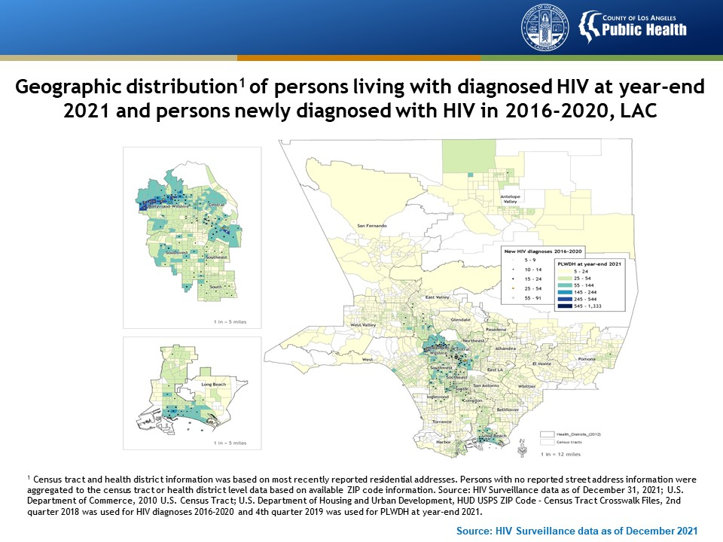
Source: HIV Surveillance data as of December 2021
Notes:
This map presents the geographic distribution of persons living with diagnosed HIV at year-end 2021 and persons newly diagnosed with HIV (2016-2020) in Los Angeles County. HIV in LAC is concentrated in certain geographic areas, with the highest density of new HIV diagnoses residing in the central and southern regions. Among all 26 Health Districts, Hollywood-Wilshire, Central, and Long Beach Health Districts were identified as three epicenters for HIV, reporting the largest numbers of new HIV diagnoses in 2016-2020 and persons living with diagnosed HIV at year-end 2021. We have zoomed in on the three epicenters with the highest concentration of new HIV diagnoses and PLWDH.
Census tract and health district information was based on most recently reported residential addresses. Persons with no reported street address information were aggregated to the census tract or health district level data based on available ZIP code information. Source: HIV Surveillance data as of December 31, 2021; U.S. Department of Commerce, 2010 U.S. Census Tract; U.S. Department of Housing and Urban Development, HUD USPS ZIP Code – Census Tract Crosswalk Files, 2nd quarter 2018 was used for HIV diagnoses 2016-2020 and 4th quarter 2019 was used for PLWDH at year-end 2021.

Slide 10
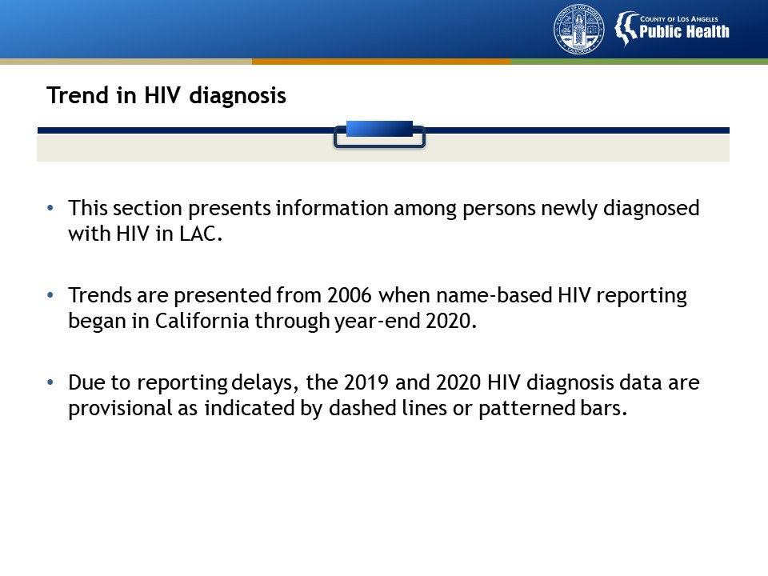

Slide 11
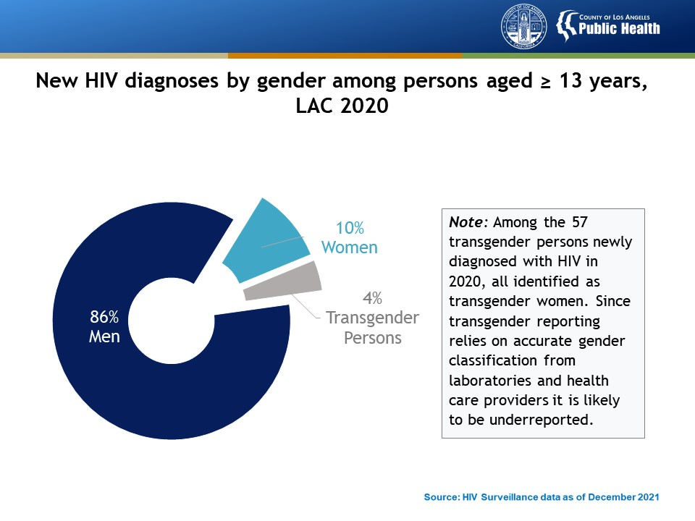
Notes:
This slide presents the proportion of HIV diagnoses by gender among persons aged ≥ 13 years in Los Angeles County in 2020. Men made up most of the new HIV diagnoses in 2020 (N=1,201, 86%). Women (N=143, 10%) and transgender persons (N=57, 4%) represented a much lower number and percentage of new HIV diagnoses in 2020.

Slide 12
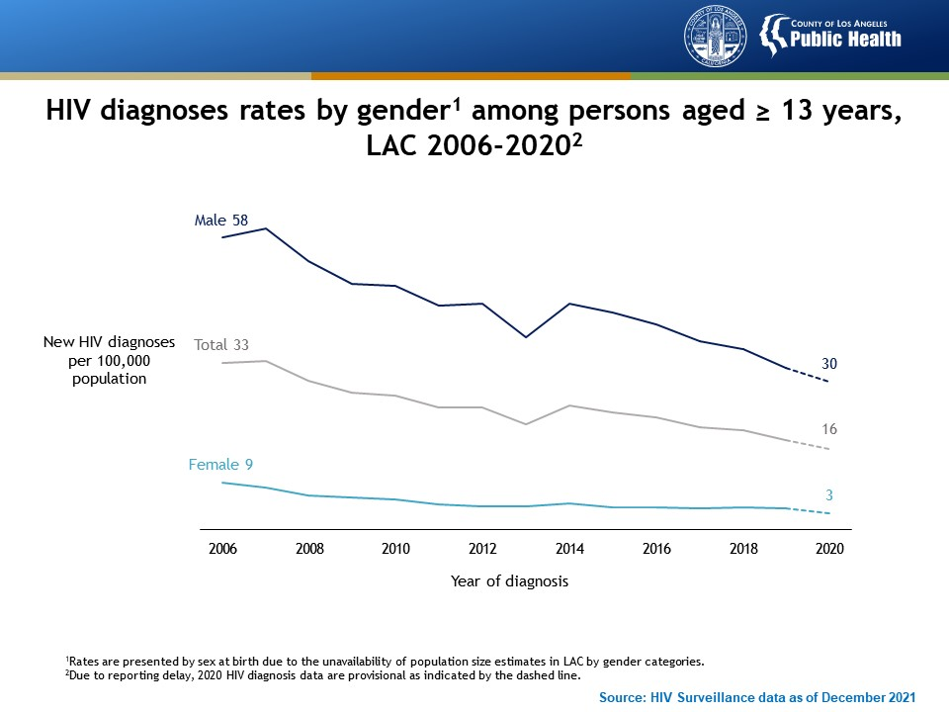
Source: HIV Surveillance data as of December 2021
Notes:
This slide presents HIV diagnoses rates among persons aged ≥13 years in Los Angeles County from 2006 to 2020, by gender. HIV diagnoses rates remain substantially higher among males than females but on the decline for both groups.
Rates are presented by sex at birth due to the unavailability of population size estimates in LAC by gender categories.
Due to reporting delay, 2020 HIV diagnosis data are provisional as indicated by the dashed line.

Slide 13
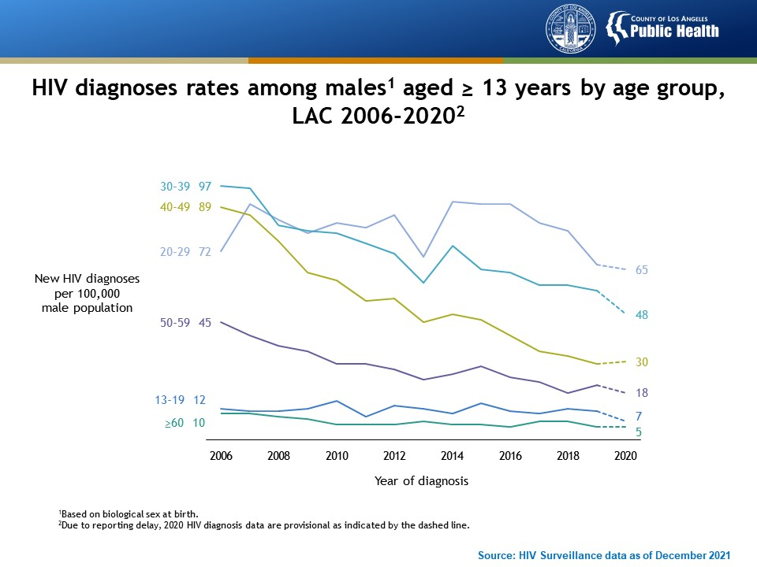
Notes:
This slide presents HIV diagnoses rates among males aged ≥13 years in Los Angeles County from 2006 to 2020, by age group. Since 2006, HIV diagnoses rates have declined among males across age groups. Rates among males aged 20-29 years increased after 2006 and decreased since 2014.
Data are based on biological sex at birth.
Due to reporting delay, 2020 HIV diagnosis data are provisional as indicated by the dashed line.

Slide 14
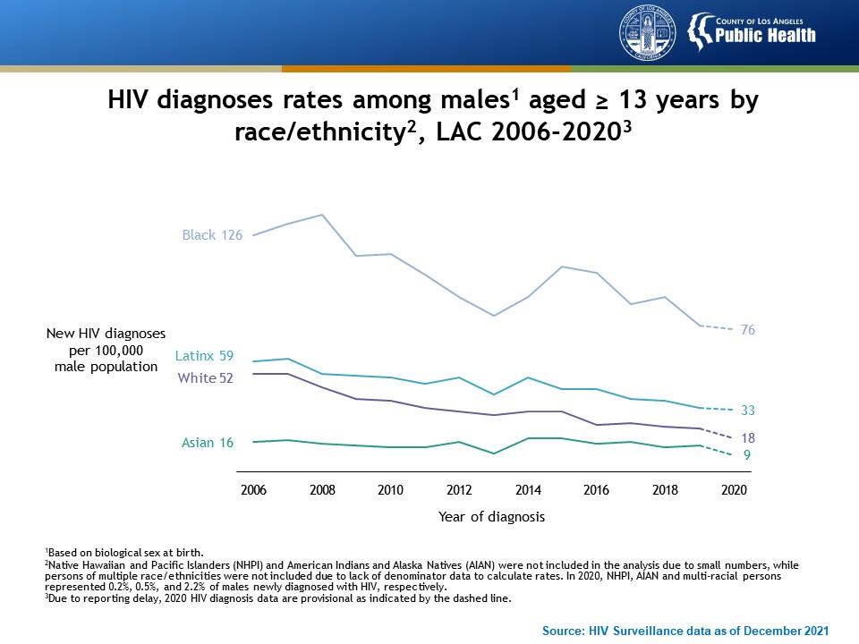
Notes:
This slide presents HIV diagnoses rates among males aged ≥13 years in Los Angeles County from 2006 to 2020 by race/ethnicity. Between 2006 to 2013, HIV diagnoses rates declined for males in all race/ethnicity groups. After 2013, HIV diagnoses rates increased among Black, Latinx, and Asian males, and after 2015, rates declined in these groups. Though Blacks have higher HIV diagnoses rates than other race/ethnicity groups, the difference is narrowing.
Data are based on biological sex at birth.
Native Hawaiian and Pacific Islanders (NHPI) and American Indians and Alaska Natives (AIAN) were not included in the analysis due to small numbers, while persons of multiple race/ethnicities were not included due to lack of denominator data to calculate rates. In 2020, NHPI, AIAN and multi-racial persons represented 0.2%, 0.5%, and 2.2% of males newly diagnosed with HIV, respectively.
Due to reporting delay, 2020 HIV diagnosis data are provisional as indicated by the dashed line.

Slide 15
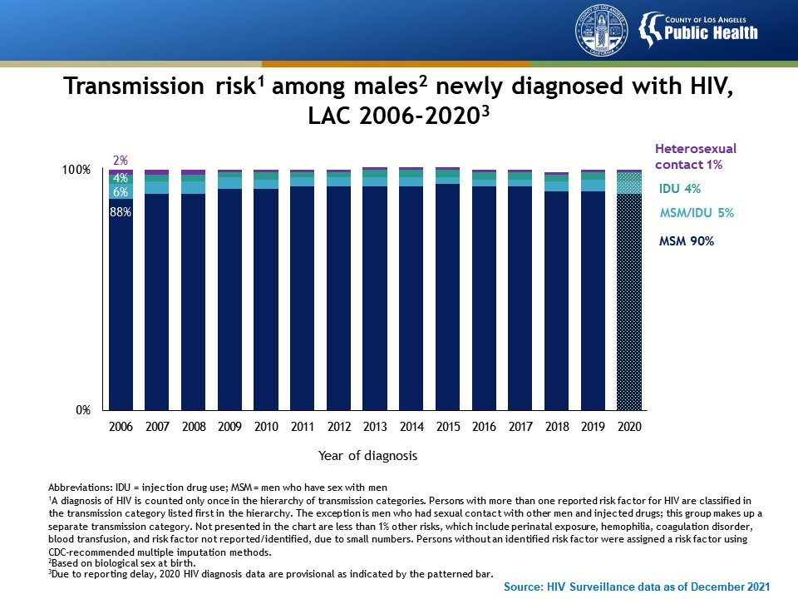
Notes:
This graph presents transmission risks among males newly diagnosed with HIV in Los Angeles County from 2006 to 2020. The primary HIV transmission risk for males is having sex with other men.
Data are based on biological sex at birth.
A diagnosis of HIV is counted only once in the hierarchy of transmission categories. Persons with more than one reported risk factor for HIV are classified in the transmission category listed first in the hierarchy. The exception is men who had sexual contact with other men and injected drugs; this group makes up a separate transmission category. Not presented in the chart are less than 1% other risks, which include perinatal exposure, hemophilia, coagulation disorder, blood transfusion, and risk factor not reported/identified, due to small numbers. Persons without an identified risk factor were assigned a risk factor using CDC-recommended multiple imputation methods.
Due to reporting delay, 2020 HIV diagnosis data are provisional as indicated by the patterned bar.

Slide 16
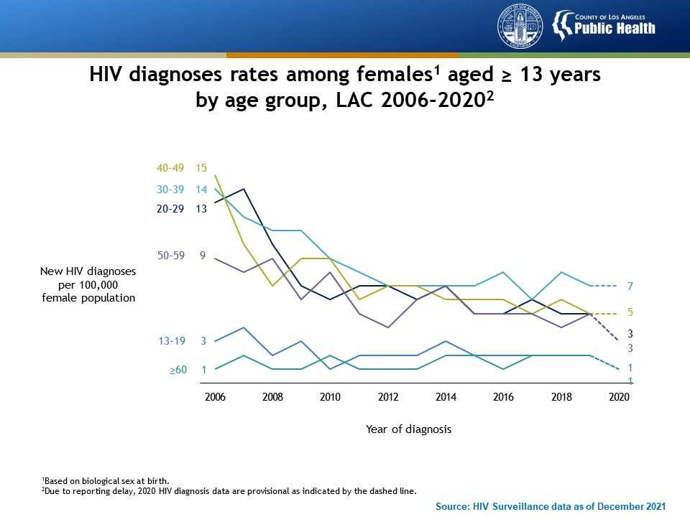
Notes:
This slide presents HIV diagnoses rates among females aged ≥13 years in Los Angeles County from 2006 to 2020, by age group. HIV diagnoses rates have declined for females between the ages of 20 and 59 years. Rates have remained low and relatively stable among females aged 13-19 years and 60 years and older.
Data based on biological sex at birth.
Due to reporting delay, 2020 HIV diagnosis data are provisional as indicated by the dashed line.

Slide 17
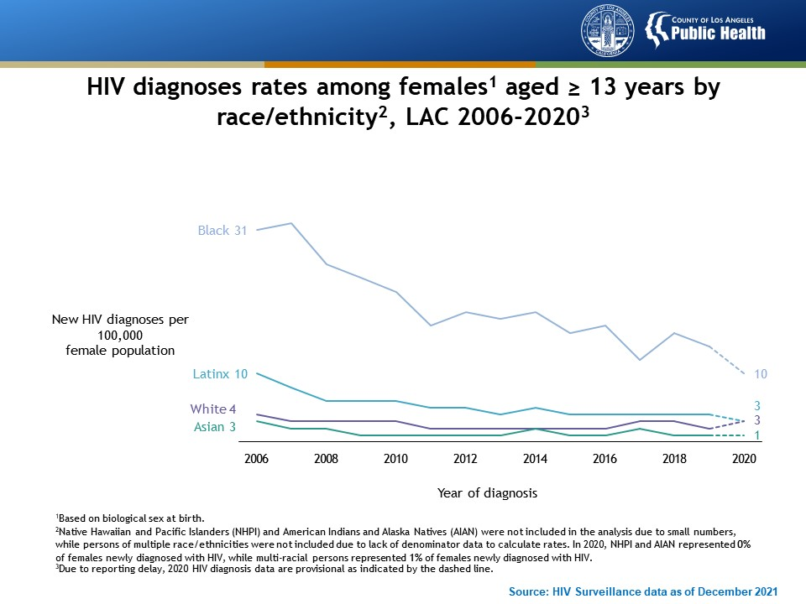
Notes:
This slide presents HIV diagnoses rates among females aged ≥13 years in Los Angeles County from 2006 to 2020, by race/ethnicity. Between 2006 to 2020, HIV diagnoses rates declined in all racial/ethnic groups. Although rates declined by 68% among Black females their rates remained the highest compared with other racial/ethnic groups.
Data are based on biological sex at birth.
Native Hawaiian and Pacific Islanders (NHPI) and American Indians and Alaska Natives (AIAN) were not included in the analysis due to small numbers, while persons of multiple race/ethnicities were not included due to lack of denominator data to calculate rates. In 2020, NHPI and AIAN represented 0% of females newly diagnosed with HIV, while multi-racial persons represented 1% of females newly diagnosed with HIV.
Due to reporting delay, 2020 HIV diagnosis data are provisional as indicated by the dashed line and patterned bar.

Slide 18
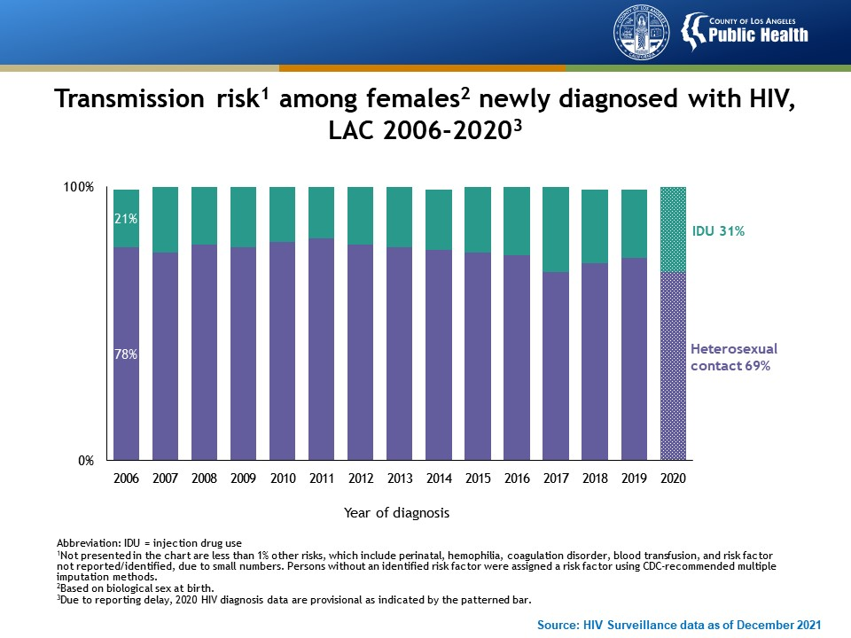
Notes:
This graph presents transmission risks among females newly diagnosed with HIV in Los Angeles County from 2006 to 2020. The primary HIV transmission route among females newly diagnosed with HIV was heterosexual contact, followed by injection drug use (IDU). In 2020, the percentage of cases with IDU as the primary transmission route increased to 31% compared to 25% in the previous year.
Not presented in the chart are other risks, which include perinatal, hemophilia, coagulation disorder, blood transfusion, and risk factor not reported/identified, due to small numbers. Persons without an identified risk factor were assigned a risk factor using CDC-recommended multiple imputation methods.
Data are based on biological sex at birth.
Due to reporting delay, 2020 HIV diagnosis data are provisional as indicated by the dashed line and patterned bar.

Slide 19
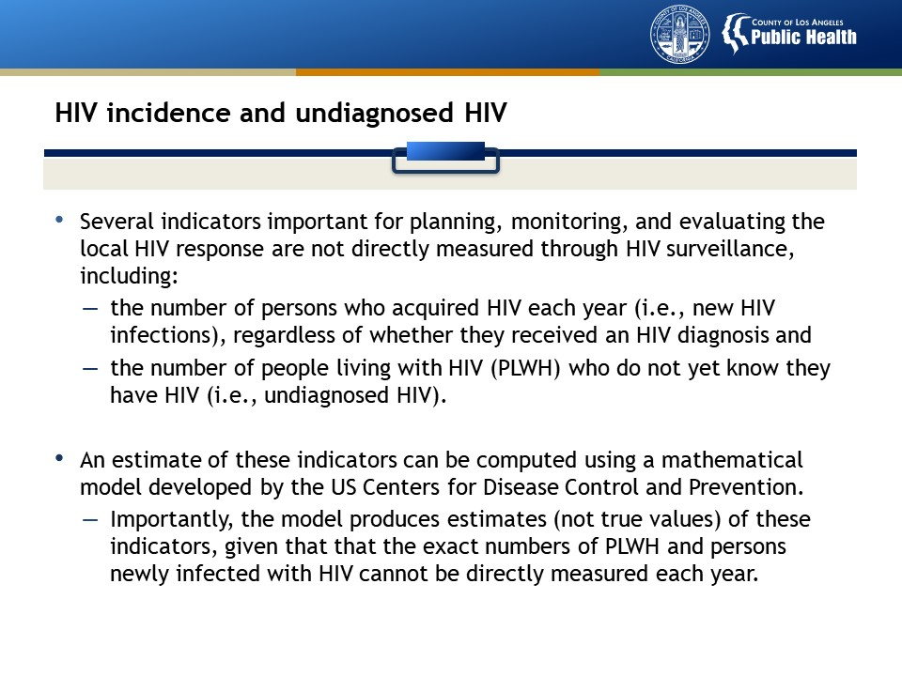

Slide 20
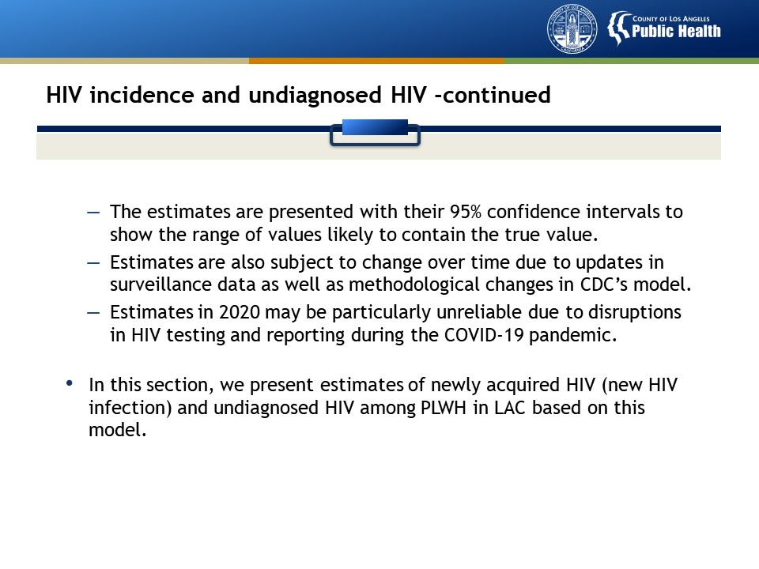

Slide 21
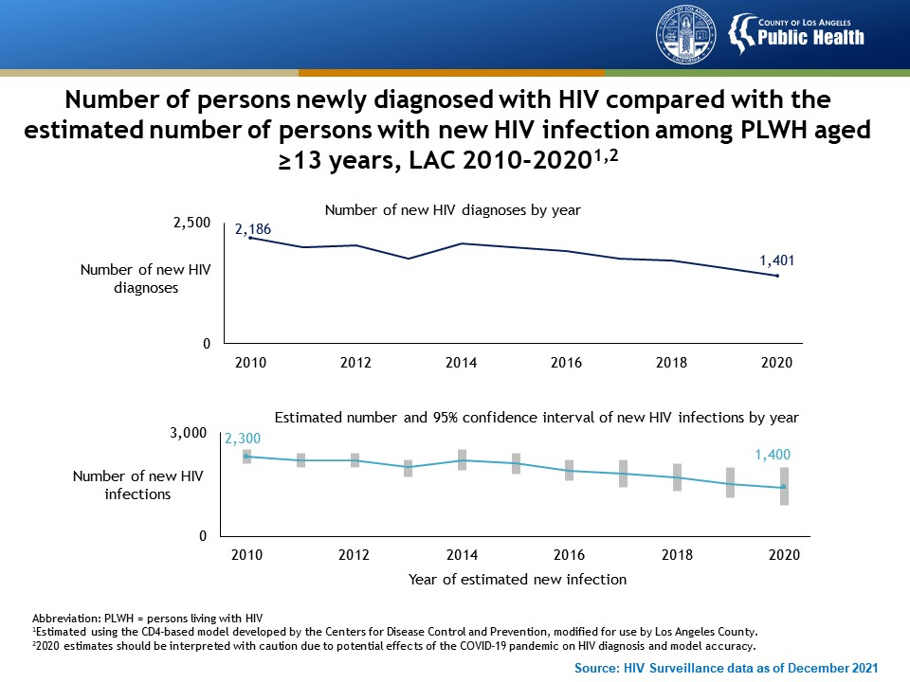
Notes:
This slide compares the annual number of new HIV diagnoses with the estimated annual number of new HIV infections among persons living with HIV aged ≥13 years in Los Angeles County from 2010 to 2020. The number of persons newly diagnosed with HIV and the estimated number of persons who acquired HIV (new infection) have declined between 2010 and 2020. In 2020, 1,401 persons were newly diagnosed with HIV, reflecting both new and old infections. An estimated 1,400 persons acquired HIV in 2020, reflecting new infections, some of whom were not diagnosed.
The estimated number of new HIV infections was calculated using the CD4-based model developed by the Centers for Disease Control and Prevention, modified for use by Los Angeles County.
2020 estimates should be interpreted with caution due to potential effects of the COVID-19 pandemic on HIV diagnosis and model accuracy.
Note:
The annual number of new HIV diagnoses is the number of PLWH who received an HIV diagnosis in a calendar year. This information is used to monitor trends in new HIV diagnosis and quantify the need for HIV care. A new HIV diagnosis is not equivalent to a new infection that was acquired in a calendar year. Many people live years before they are diagnosed while some are diagnosed soon after acquiring HIV. Based on local data, the majority of new HIV diagnoses each year were infections acquired over a year ago.
The annual number of new HIV infections reflect infections acquired in a calendar year. Some new infections are diagnosed soon after acquiring HIV, but the majority are not. When the number of new HIV infections is high, HIV continues to spread because most people with a new infection are not aware they are living with HIV. New infections provide information on recent transmission and serve as a barometer to assess whether HIV prevention programs are reducing transmission. Trends in new infections generally track with trends in new diagnoses unless transmission is very low or high in the population.

Slide 22
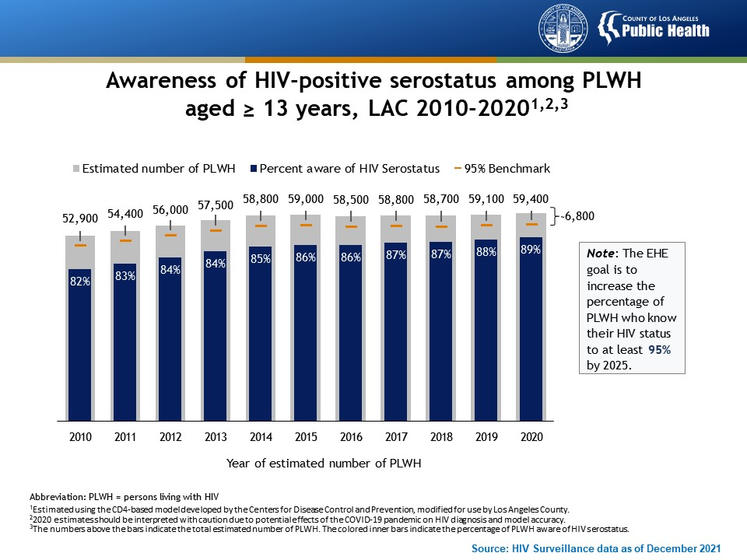
Notes:
This graph presents the awareness of HIV-positive serostatus among persons living with HIV (PLWH) aged ≥13 years in Los Angeles County from 2010 to 2020. In 2020, an estimated 89% of PLWH were aware of their HIV serostatus. Approximately 6,800 PLWH remained unaware of their HIV infection.
Estimated using the CD4-based model developed by the Centers for Disease Control and Prevention, modified for use by Los Angeles County.
2020 estimates should be interpreted with caution due to potential effects of the COVID-19 pandemic on HIV diagnosis and model accuracy.
The numbers above the bars indicate the total estimated number of PLWH. The colored inner bars indicate the percentage of PLWH aware of HIV serostatus.

Slide 23
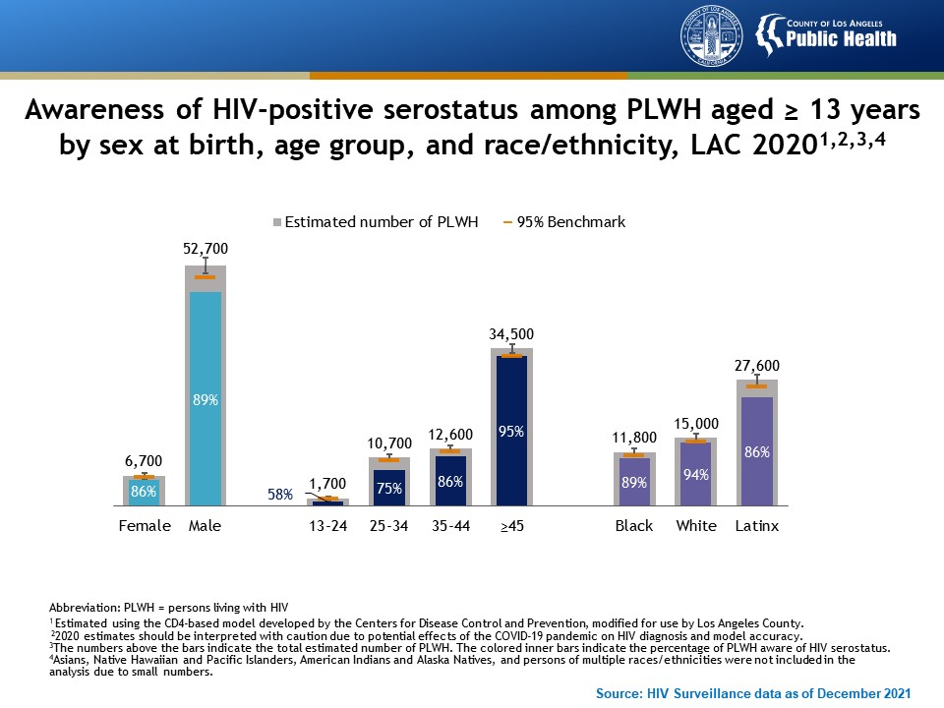
Notes:
This graph presents the awareness of HIV-positive serostatus among persons living with HIV (PLWH) aged ≥13 years in Los Angeles County by sex at birth, age group, and race/ethnicity in 2020. The greatest disparities in awareness of HIV-positive serostatus are among young PLWH and Latinx PLWH.
Estimated using the CD4-based model developed by the Centers for Disease Control and Prevention, modified for use by Los Angeles County.
2020 estimates should be interpreted with caution due to potential effects of the COVID-19 pandemic on HIV diagnosis and model accuracy.
The numbers above the bars indicate the total estimated number of PLWH. The colored inner bars indicate the percentage of PLWH aware of HIV serostatus.
Asians, Native Hawaiian and Pacific Islanders, American Indians and Alaska Natives, and persons of multiple races/ethnicities were not included in the analysis due to small numbers.

Slide 24
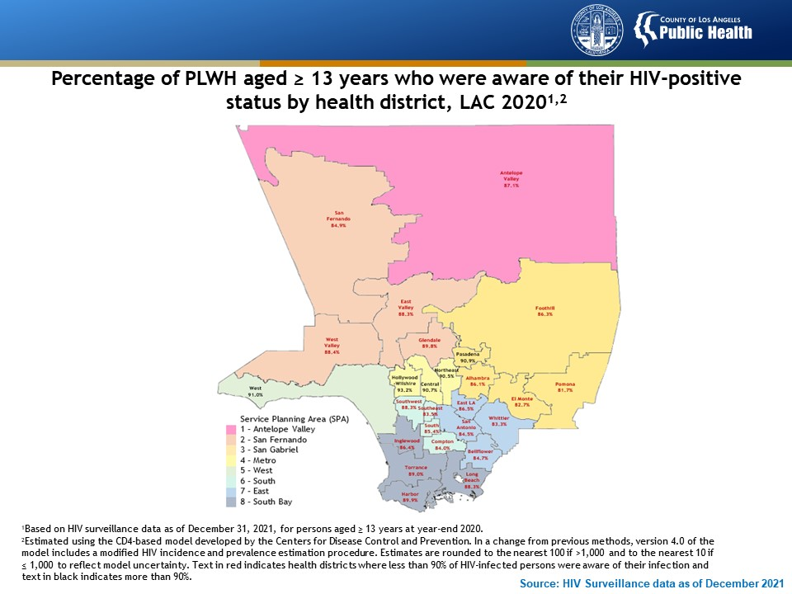
Notes:
This figure shows the percentage of persons living with HIV (PLWH) who were aware of their HIV-positive status by health district in 2020 in Los Angeles County. The percentage of persons living with HIV who are aware of their HIV-positive status varies by location. None of the 26 Health Districts have met the EHE target for 95% of PLWH who know their HIV-positive status. There are five Health Districts nearing this target with at least 90% of PLWH aware of their HIV status. These Health Districts are noted in black and include West, Hollywood-Wilshire, Central, Northeast, and Pasadena.
Based on HIV surveillance data as of December 31, 2021, for persons aged ≥ 13 years at year-end 2020.
Estimated using the CD4-based model developed by the Centers for Disease Control and Prevention. In a change from previous methods, version 4.0 of the model includes a modified HIV incidence and prevalence estimation procedure. Estimates are rounded to the nearest 100 if >1,000 and to the nearest 10 if ≤ 1,000 to reflect model uncertainty. Text in red indicates health districts where less than 90% of HIV-infected persons were aware of their infection and text in black indicates more than 90%.

Slide 25
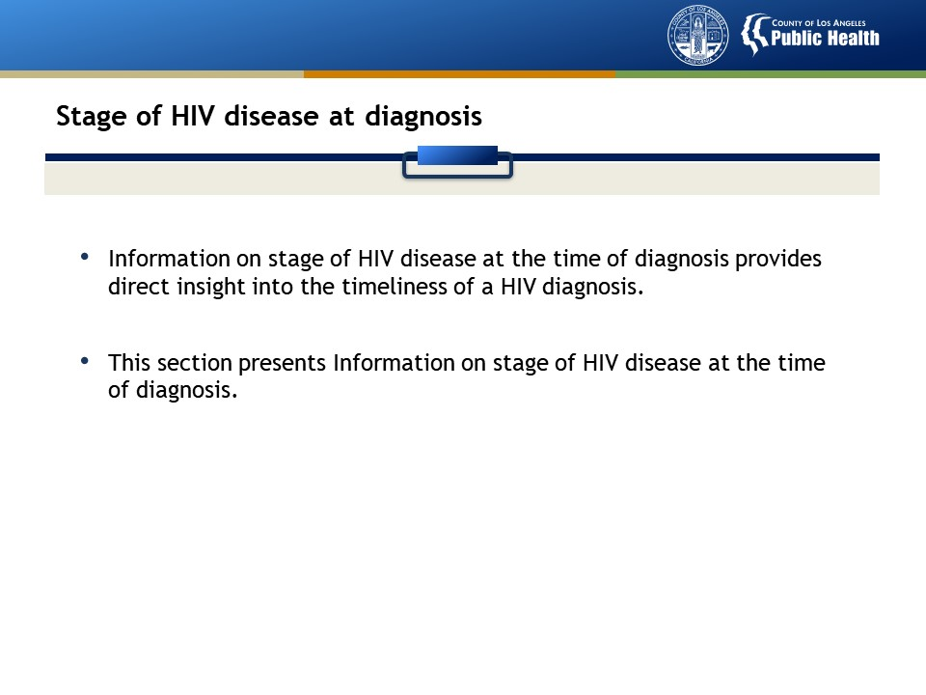

Slide 26
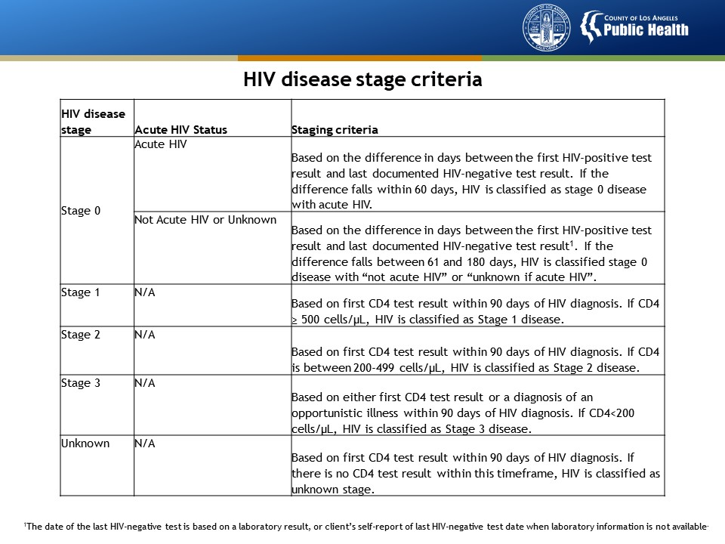
Notes:
This table presents the stages of HIV disease and the criteria for each stage. The HIV surveillance case definition of HIV has four stages: Stage 0, 1, 2, and 3. Stage 0 HIV disease indicates early infection which includes acute HIV (infection occurred within 60 days of HIV diagnosis) and early but not acute HIV (infection occurred within 61-180 days of HIV diagnosis).
The date of the last HIV-negative test is based on a laboratory result, or client’s self-report of last HIV-negative test date when laboratory information is not available.

Slide 27
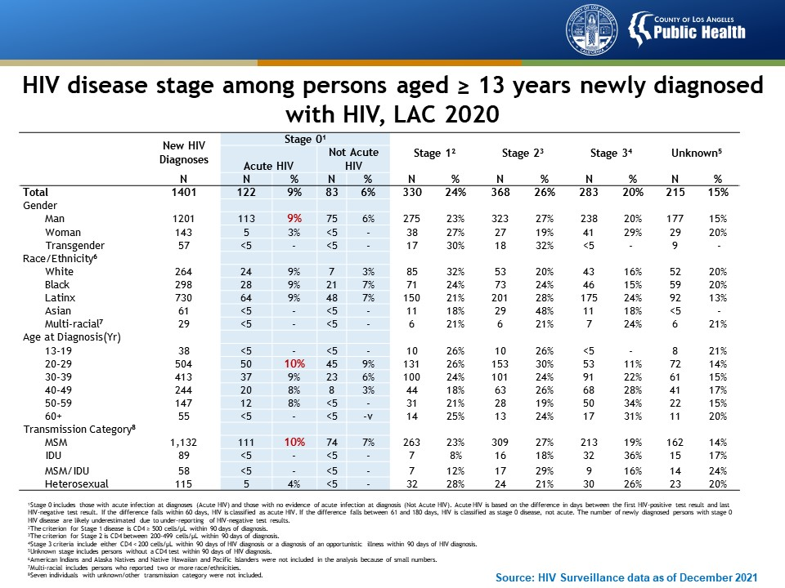
Notes:
This table shows the HIV disease stage among persons aged ≥13 years newly diagnosed with HIV in Los Angeles County in 2020, by selected demographic and risk characteristics. In 2020, 15% of new HIV diagnoses were diagnosed at Stage 0 (an indicator of recent infection). Over half of those diagnosed at Stage 0 had acute HIV at diagnosis. The proportion of PLWDH with acute HIV was highest among men, persons aged 20-29 years, and MSM.
Stage 0 includes those with acute infection at diagnoses (Acute HIV) and those with no evidence of acute infection at diagnosis (Not Acute HIV). Acute HIV is based on the difference in days between the first HIV-positive test result and last HIV-negative test result. If the difference falls within 60 days, HIV is classified as acute HIV. If the difference falls between 61 and 180 days, HIV is classified as stage 0 disease, not acute. The number of newly diagnosed persons with stage 0 HIV disease are likely underestimated due to under-reporting of HIV-negative test results.
The criterion for Stage 1 disease is CD4 ≥ 500 cells/µL within 90 days of diagnosis.
The criterion for Stage 2 is CD4 between 200-499 cells/µL within 90 days of diagnosis.
Stage 3 criteria include either CD4 < 200 cells/µL within 90 days of HIV diagnosis or a diagnosis of an opportunistic illness within 90 days of HIV diagnosis.
Unknown stage includes persons without a CD4 test within 90 days of HIV diagnosis.
American Indians and Alaska Natives and Native Hawaiian and Pacific Islanders were not included in the analysis because of small numbers.
Multi-racial includes persons who reported two or more race/ethnicities.
Seven individuals with unknown/other transmission category were not included.

Slide 28
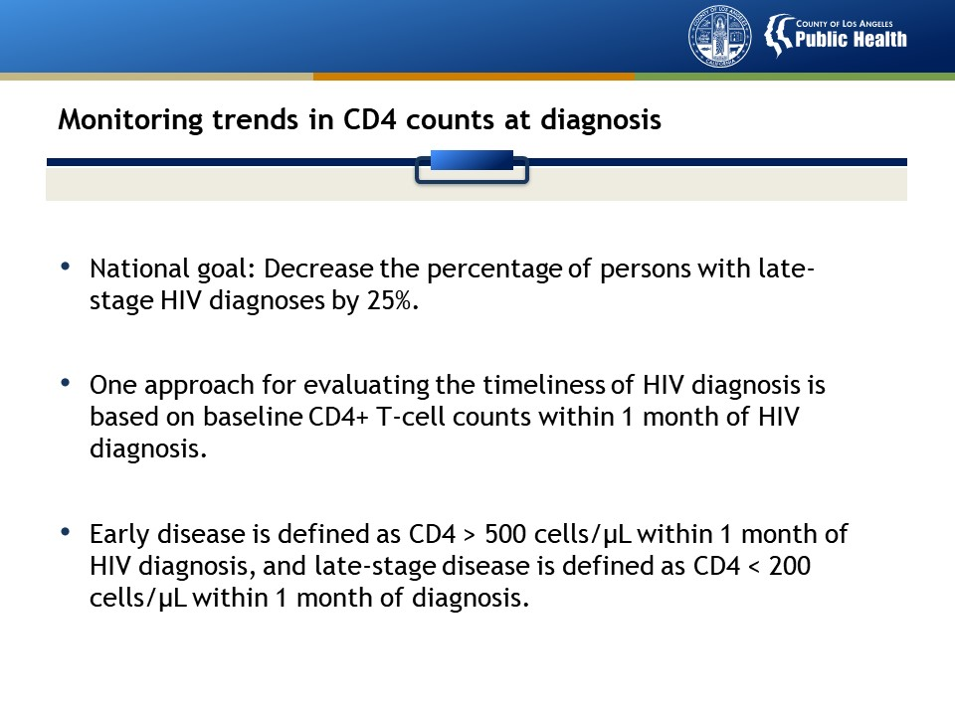

Slide 29
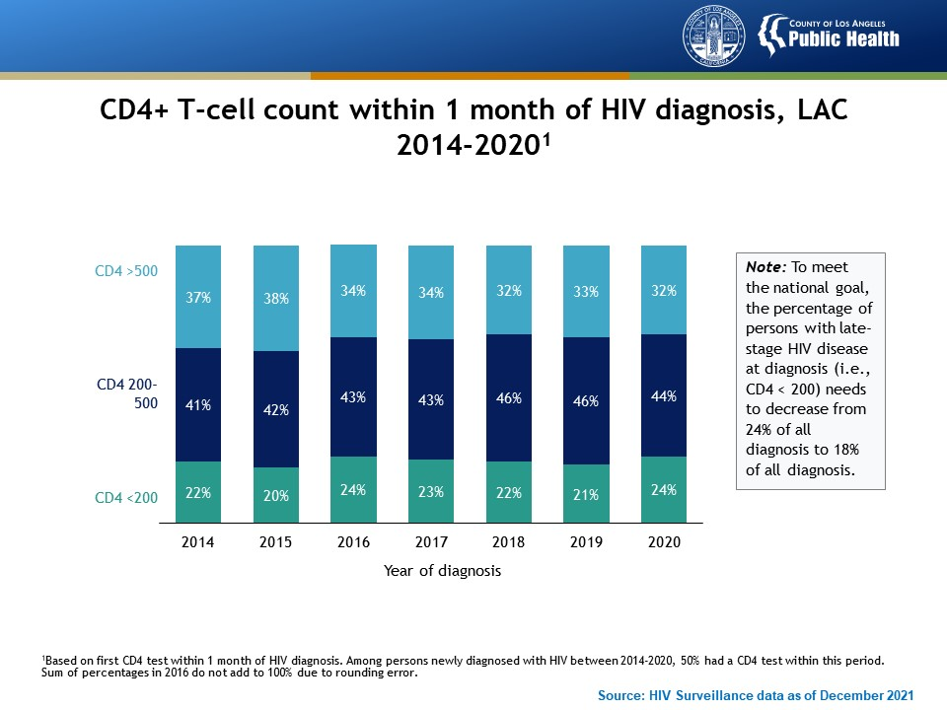
Notes:
This graph presents CD4+ T-cell counts within 1 month of HIV diagnosis in Los Angeles County between 2014 and 2020. One in four new HIV diagnoses presented with CD4+ T-cells < 200 cells/µL at the time of diagnosis in 2020, indicative of late HIV disease. The percentage of persons presenting with late HIV disease increased slightly between 2019 and 2020.
These results are based on the first CD4 test within 1 month of HIV diagnosis. Among persons newly diagnosed with HIV between 2014-2020, 50% had a CD4 test within this period. Sum of percentages in 2016 do not add to 100% due to rounding error.

Slide 30
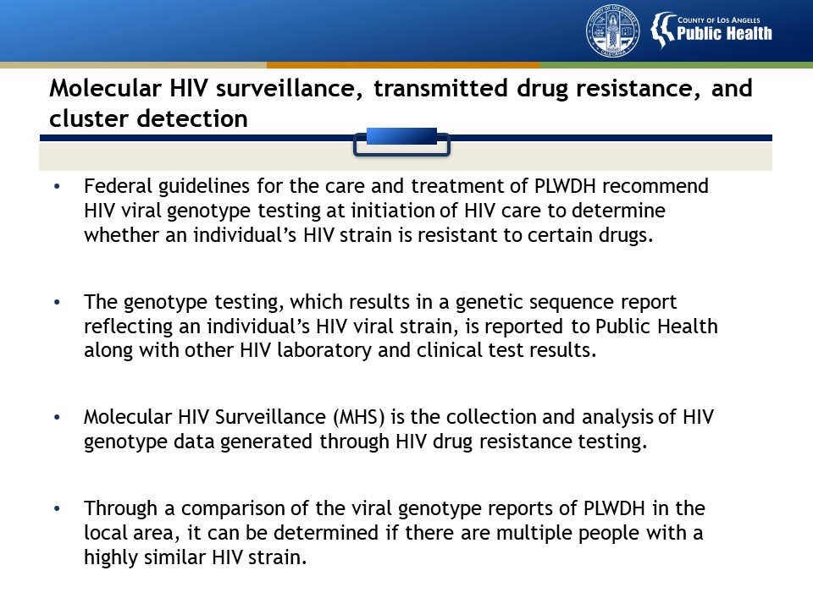

Slide 31
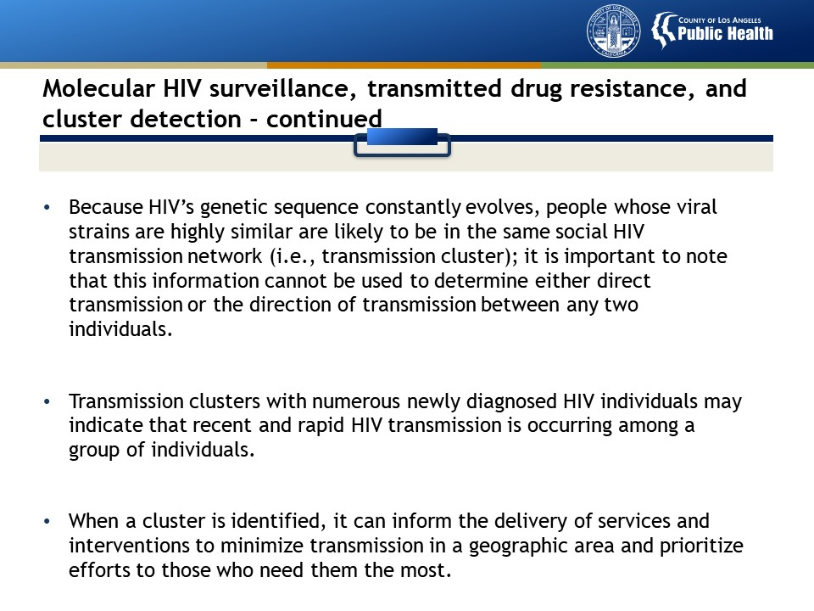

Slide 32
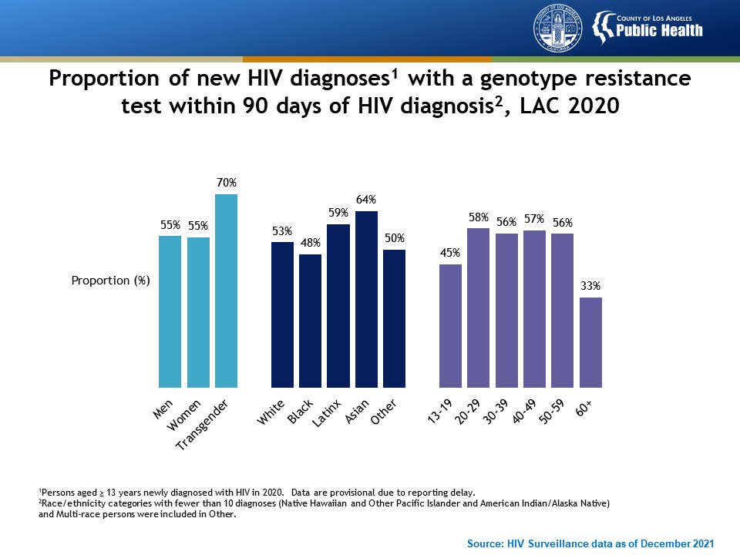
Notes:
This figure shows proportion of new HIV diagnoses with a genotype resistance test within 90 days of HIV diagnosis, LAC 2020. Genotypic resistance testing is recommended at entry into HIV care to guide treatment. In 2020, 56% of newly diagnosed cases received a genotype within 90 days of diagnosis. The proportion of new diagnoses with a genotype within 90 days was highest among transgender persons, Asians, and those aged 20 to 29.
Denominator: persons aged ≥ 13 years newly diagnosed with HIV in 2020. Data are provisional due to reporting delay.
Race/ethnicity categories with fewer than 10 diagnoses (Native Hawaiian and Other Pacific Islander and American Indian/Alaska Native) and Multi-race persons were included in Other.

Slide 33
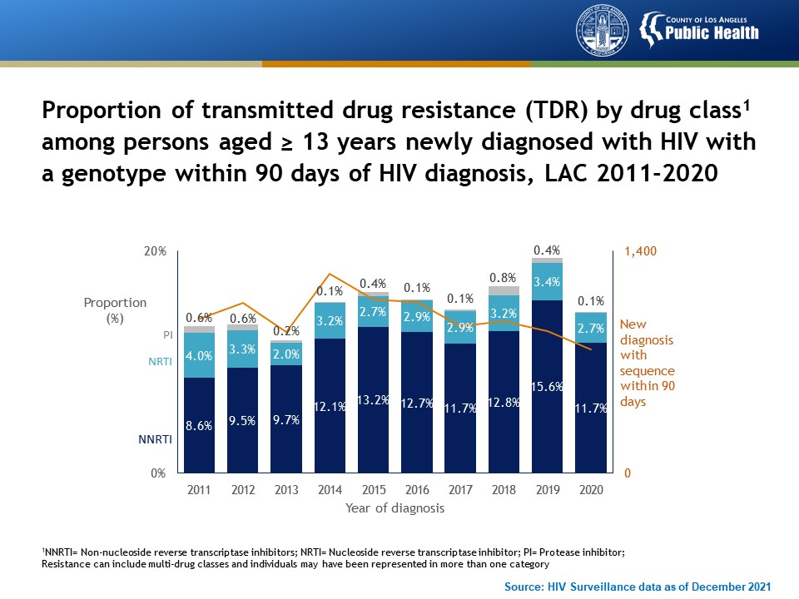
Notes:
This figure shows proportion of transmitted drug resistance (TDR) by drug class among persons aged ≥ 13 years newly diagnosed with HIV with a genotype within 90 days of HIV diagnosis, LAC 2011-2020 . From 2011 to 2020 the percentage of specimens from persons newly diagnosed with HIV were tested for HIV drug resistance with 90 days of diagnosis ranged from 50% to 60%. Within that timeframe the proportion of specimens showing evidence of resistance to one or more antiretroviral drugs remained between 11% and 19%. In 2020, about 14% of specimens expressed resistance to one or more antiretroviral drugs. Of the three major drug classes, transmitted drug resistance to non-nucleoside reverse transcriptase (NNRTI) inhibitors was the highest. The proportion of specimens with resistance to integrase inhibitors did not exceed more than 0.1% (data not shown).
NNRTI= Non-nucleoside reverse transcriptase inhibitors; NRTI= Nucleoside reverse transcriptase inhibitor; PI= Protease inhibitor; Resistance can include multi-drug classes and individuals may have been represented in more than one category

Slide 34
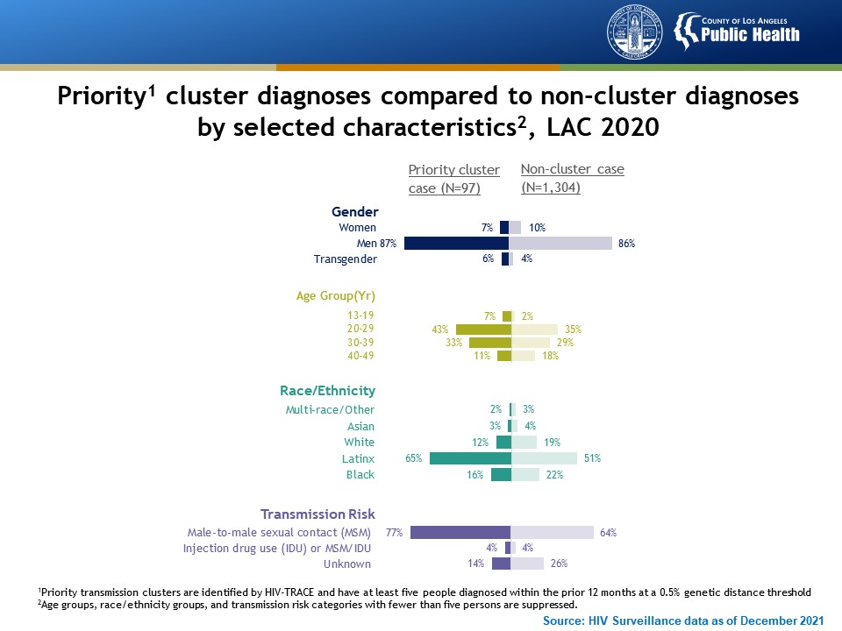
Notes:
This figure shows priority cluster diagnoses compared to non-cluster diagnoses by selected characteristics, LAC 2020 . In 2020, 7% of persons newly diagnosed with HIV were associated with a priority transmission cluster. These persons were more likely to be aged 20-29 years, Latinx, and have MSM transmission risk compared with persons newly diagnosed with HIV who were not associated with a priority cluster. Persons associated with a priority transmission cluster were also more likely to reside in the Southeast, San Antonio, Northeast, and Antelope Valley Health Districts; report methamphetamine use and anonymous partners; have syphilis co-infection; receive a partner services interview; and be virally suppressed.
Priority transmission clusters are identified by HIV-TRACE and have at least five people diagnosed within the prior 12 months at a 0.5% genetic distance threshold.
Age groups, race/ethnicity groups, and transmission risk categories with fewer than five persons are suppressed.

Slide 35
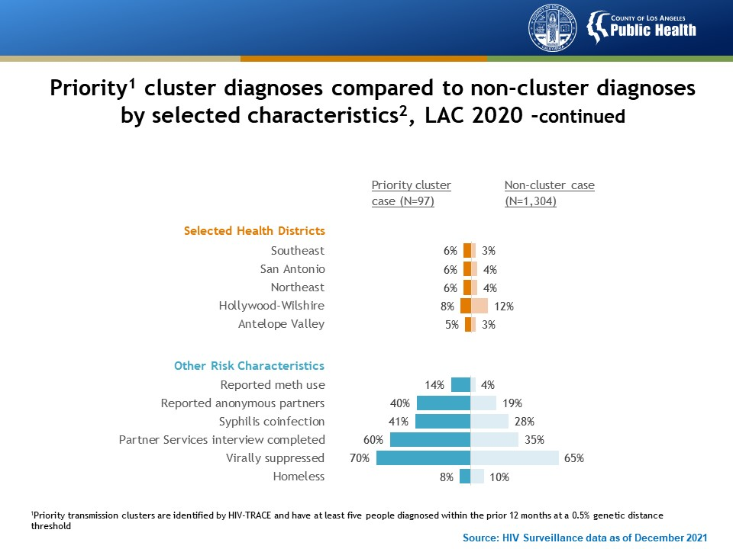
Notes:
This figure shows priority cluster diagnoses compared to non-cluster diagnoses by selected characteristics, LAC 2020 . In 2020, 7% of persons newly diagnosed with HIV were associated with a priority transmission cluster. These persons were more likely to be aged 20-29 years, Latinx, and have MSM transmission risk compared with persons newly diagnosed with HIV who were not associated with a priority cluster. Persons associated with a priority transmission cluster were also more likely to reside in the Southeast, San Antonio, Northeast, and Antelope Valley Health Districts; report methamphetamine use and anonymous partners; have syphilis co-infection; receive a partner services interview; and be virally suppressed.
Priority transmission clusters are identified by HIV-TRACE and have at least five people diagnosed within the prior 12 months at a 0.5% genetic distance threshold.

Slide 36
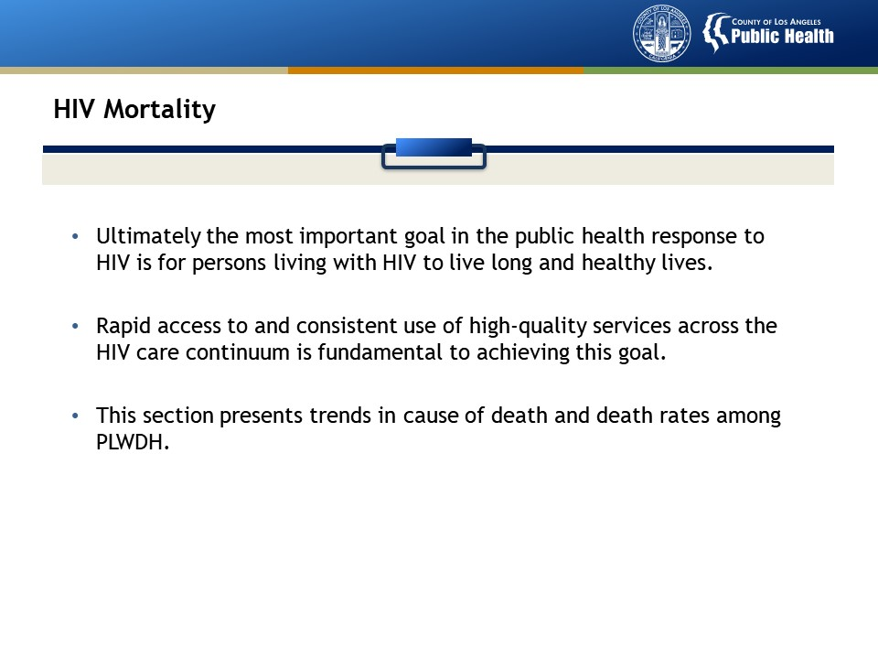

Slide 37
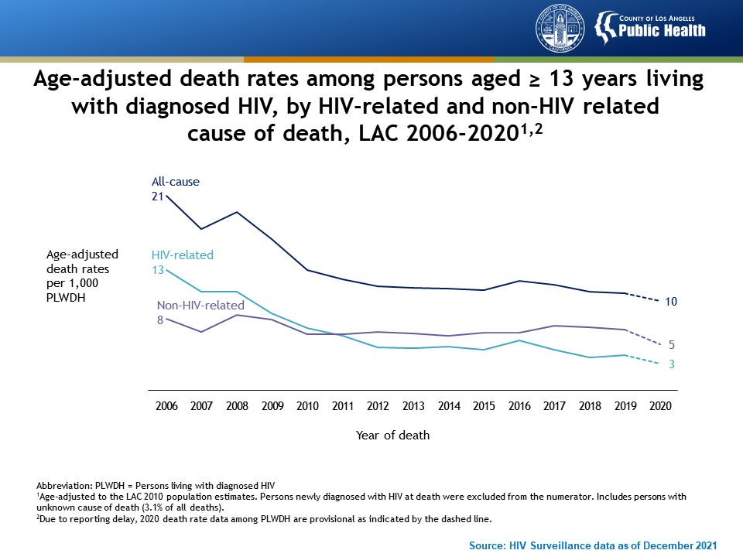
Notes:
This graph presents age-adjusted death rates among persons aged ≥ 13 years living with diagnosed HIV in Los Angeles County, by HIV-related and non-HIV related cause of death, from 2006 to 2020. The age-adjusted death rate among persons diagnosed with HIV dropped 52% from 2006 to 2020. The rate attributed to HIV-related and non-HIV-related death declined by 77% and 38%, respectively.
Death rates were age-adjusted to the LAC 2010 population estimates. Persons newly diagnosed with HIV at death were excluded from the numerator. Includes persons with unknown cause of death (3.1% of all deaths).
Due to reporting delay, 2020 death rate data among PLWDH are provisional as indicated by the dashed line.

Slide 38
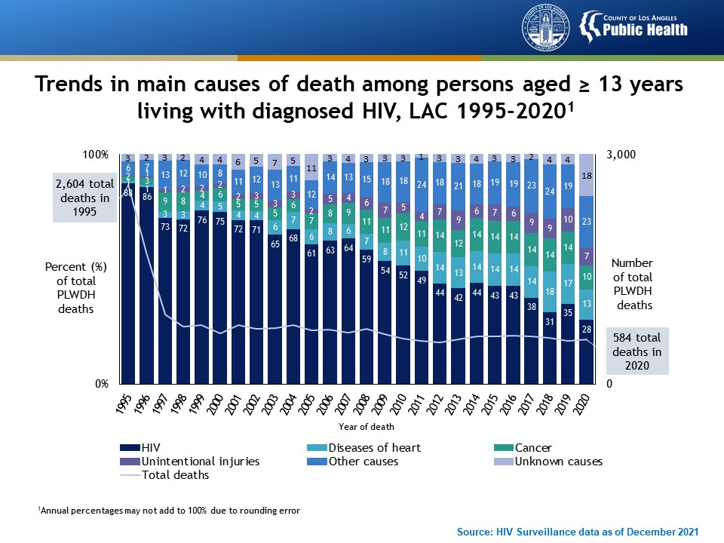
Notes:
This graph presents trends in main causes of death among persons aged ≥ 13 years living with diagnosed HIV in Los Angeles County from 1995 to 2020. The number of deaths among PLWDH decreased sharply following the introduction of highly active antiretroviral treatment in 1996 and has remained stable at approximately 500-600 deaths per year for the past decade. HIV as the leading cause of death among PLWDH declined from 88% of deaths in 1995 to 28% of deaths in 2020. In contrast, diseases of the heart as the cause of death among PLWDH increased from 1% in 1995 to 13% in 2020, followed by cancer from 2% to 10%, and unintentional injuries from <1% to 7%. Preliminary data for 2020 showed a spike among unknown causes of death, which could result from prolonged reporting delay and the lack of diagnoses during COVID-19 pandemic. In 2020, 133 PLWDH were classified as having ‘Other causes’ as their main cause of death; this included 30 PLWDH who died of COVID-19 disease.
Annual percentages may not add to 100% due to rounding error.

Slide 39
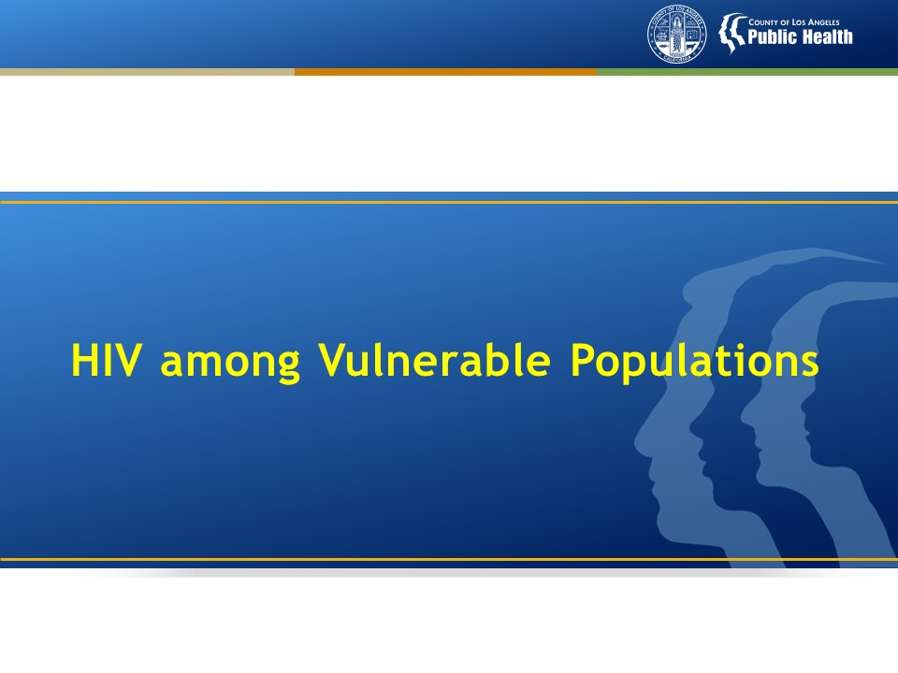

Slide 40
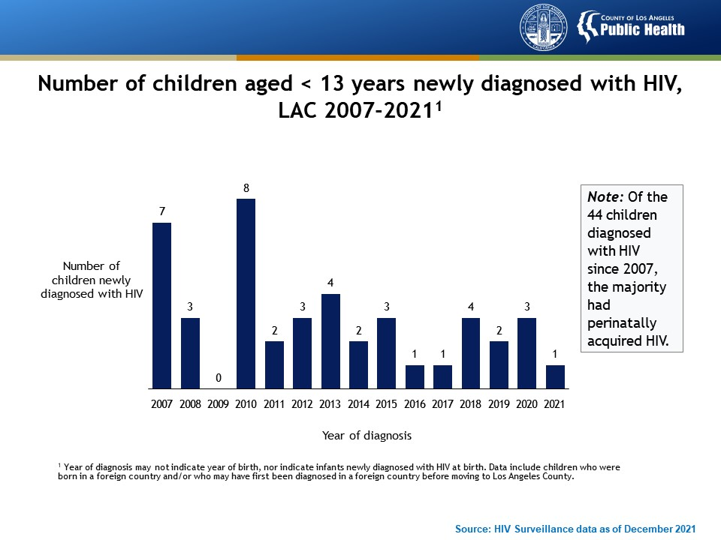
Notes:
This graph presents the number of children aged <13 years newly diagnosed with HIV in Los Angeles County between 2007 and 2021. New HIV diagnoses in children peaked in 2010 at eight cases. In 2021, there was one newly identified case of HIV in a child aged <13 years.
Year of diagnosis may not indicate year of birth, nor indicate infants newly diagnosed with HIV at birth. Data include children who were born in a foreign country and/or who may have first been diagnosed in a foreign country before moving to Los Angeles County.

Slide 41
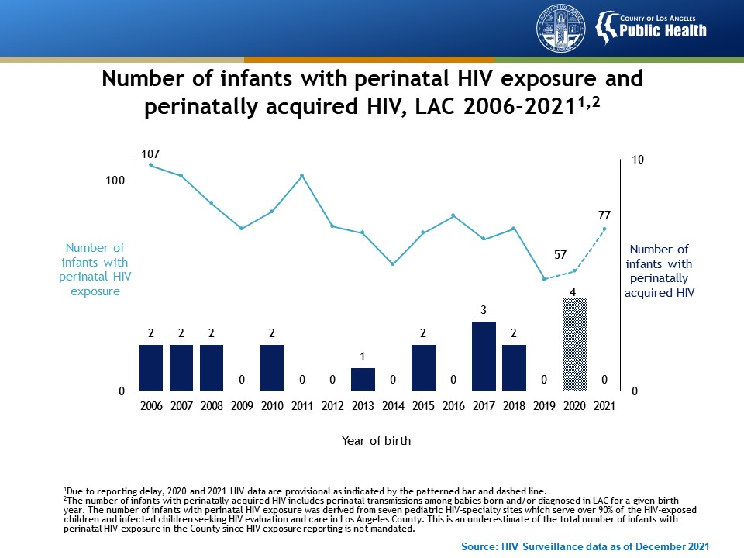
Notes:
This graph shows the number of infants with perinatal HIV exposure and the number with perinatally acquired HIV from 2006 through 2021. The number of infants with perinatal HIV exposure declined from 2006 through 2021. From 2019 through 2021, the number of perinatal exposures increased from 53 exposures to 77 exposures. At the time of writing there was no reported transmission of HIV from infected mothers to their babies in 2021.
Due to reporting delay, 2020 and 2021 HIV data are provisional as indicated by the patterned bar and dashed line.
The number of infants with perinatally acquired HIV includes perinatal transmissions among babies born and/or diagnosed in LAC for a given birth year. The number of infants with perinatal HIV exposure was derived from 7 pediatric HIV-specialty sites which serve over 90% of the HIV-exposed children and infected children seeking HIV evaluation and care in Los Angeles County. This is an underestimate of the total number of infants with perinatal HIV exposure in the County since HIV exposure reporting is not mandated.

Slide 42
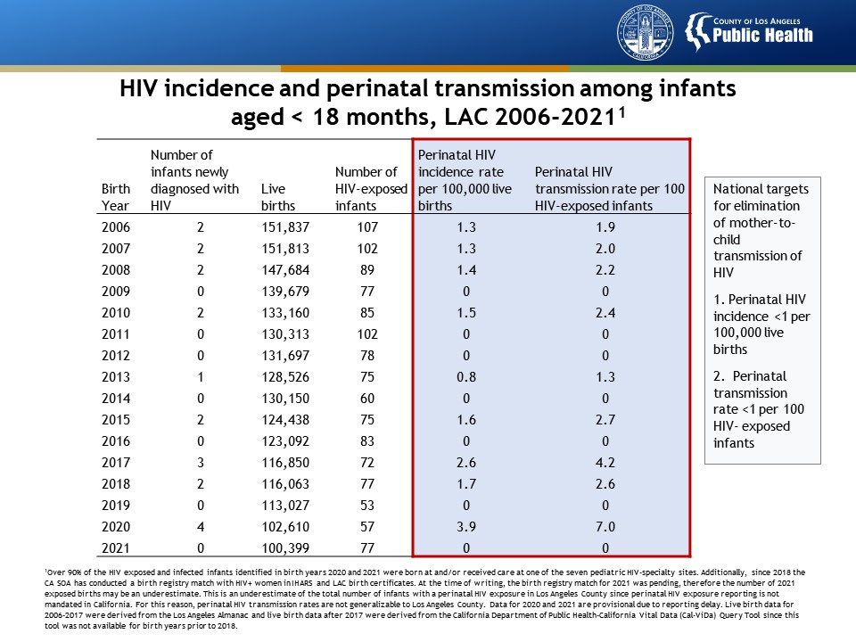
Notes:
This table presents HIV incidence and transmission among infants aged <18 months in Los Angeles County between 2006 and 2021. As of 2021, both perinatal HIV incidence and perinatal HIV transmission rates were within target for elimination of mother-to-child transmission of HIV in the US.
Over 90% of the HIV exposed and infected infants identified in birth years 2020 and 2021 were born at and/or received care at one of the seven pediatric HIV-specialty sites. Additionally, since 2018 the CA SOA has conducted a birth registry match with HIV+ women in IHARS and LAC birth certificates. At the time of writing, the birth registry match for 2021 was pending, therefore the number of 2021 exposed births may be an underestimate. This is an underestimate of the total number of infants with a perinatal HIV exposure in Los Angeles County since perinatal HIV exposure reporting is not mandated in California. For this reason, perinatal HIV transmission rates are not generalizable to Los Angeles County. Data for 2020 and 2021 are provisional due to reporting delay. Live birth data for 2006-2017 were derived from the Los Angeles Almanac and live birth data after 2017 were derived from the California Department of Public Health-California Vital Data (Cal-ViDa) Query Tool since this tool was not available for birth years prior to 2018.

Slide 43
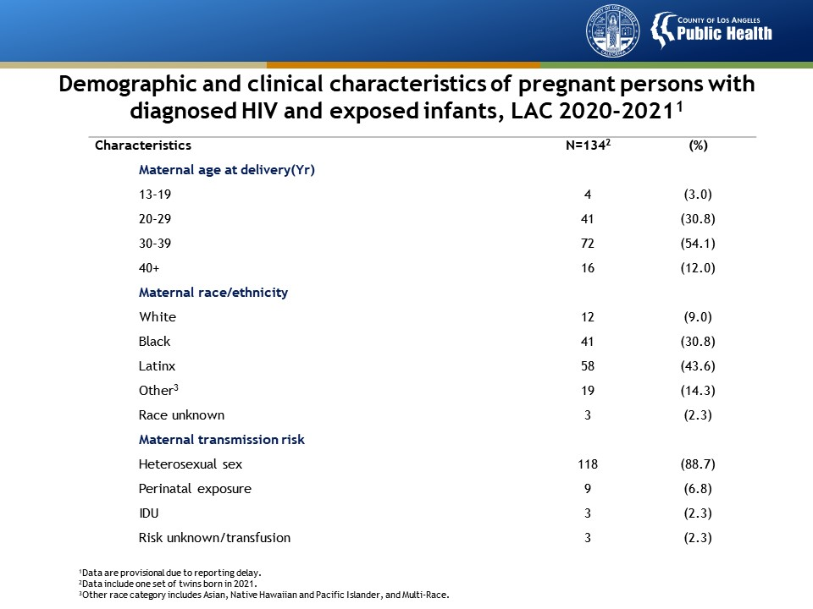
Notes:
This table presents demographic and clinical characteristics of pregnant persons with diagnosed HIV and exposed infants in LAC from 2020 to 2021. In 2020-2021, there were four confirmed HIV infections among perinatally exposed babies born in Los Angeles County. Overall, 91.7% (122/134) of women living with diagnosed HIV who gave birth in LAC received at least one arm of ART during pregnancy and/or at labor and delivery. All infants (4/4) who were perinatally infected with HIV were born to persons who were not confirmed to have received ART during pregnancy and/or delivery. Prenatal care and ART use during pregnancy and labor and delivery are an essential component of prevention of perinatal HIV transmission.

Slide 44
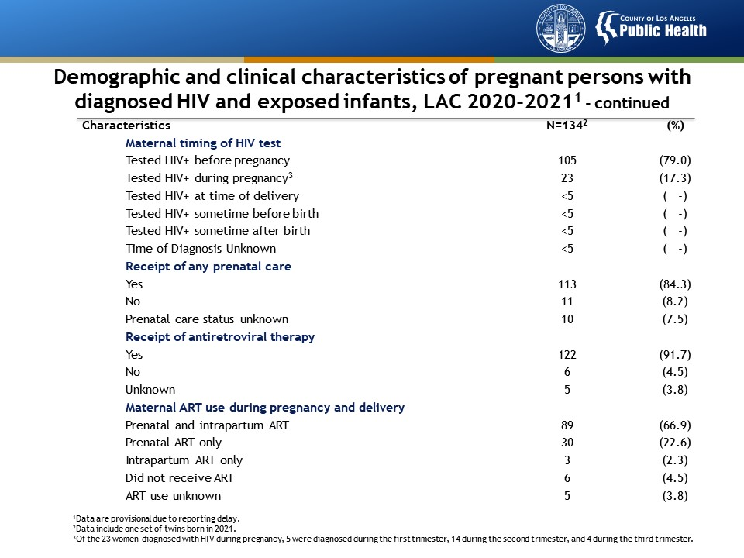
Notes:
This table presents demographic and clinical characteristics of pregnant persons with diagnosed HIV and exposed infants in LAC from 2020 to 2021. In 2020-2021, there were four confirmed HIV infections among perinatally exposed babies born in Los Angeles County. Overall, 91.7% (122/134) of women living with diagnosed HIV who gave birth in LAC received at least one arm of ART during pregnancy and/or at labor and delivery. All infants (4/4) who were perinatally infected with HIV were born to persons who were not confirmed to have received ART during pregnancy and/or delivery. Prenatal care and ART use during pregnancy and labor and delivery are an essential component of prevention of perinatal HIV transmission.

Slide 45
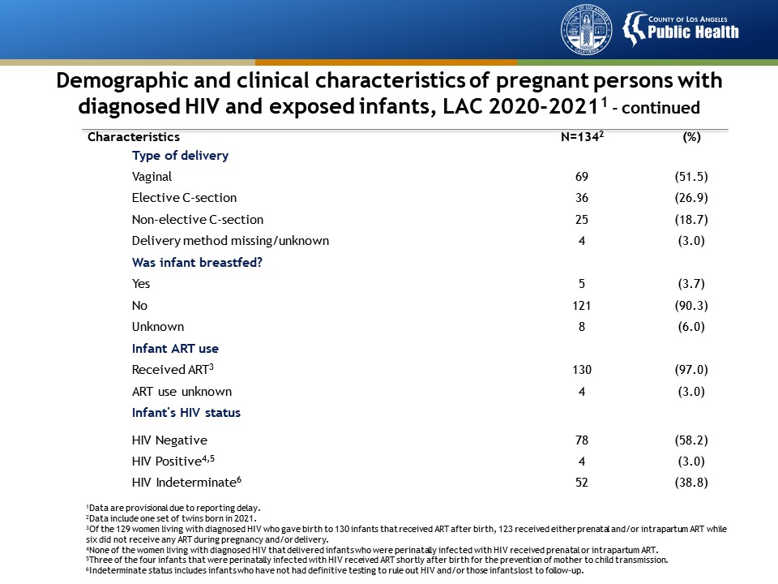
Notes:
This table presents demographic and clinical characteristics of pregnant persons with diagnosed HIV and exposed infants in LAC from 2020 to 2021. In 2020-2021, there were four confirmed HIV infections among perinatally exposed babies born in Los Angeles County. Overall, 91.7% (122/134) of women living with diagnosed HIV who gave birth in LAC received at least one arm of ART during pregnancy and/or at labor and delivery. All infants (4/4) who were perinatally infected with HIV were born to persons who were not confirmed to have received ART during pregnancy and/or delivery. Prenatal care and ART use during pregnancy and labor and delivery are an essential component of prevention of perinatal HIV transmission.

Slide 46
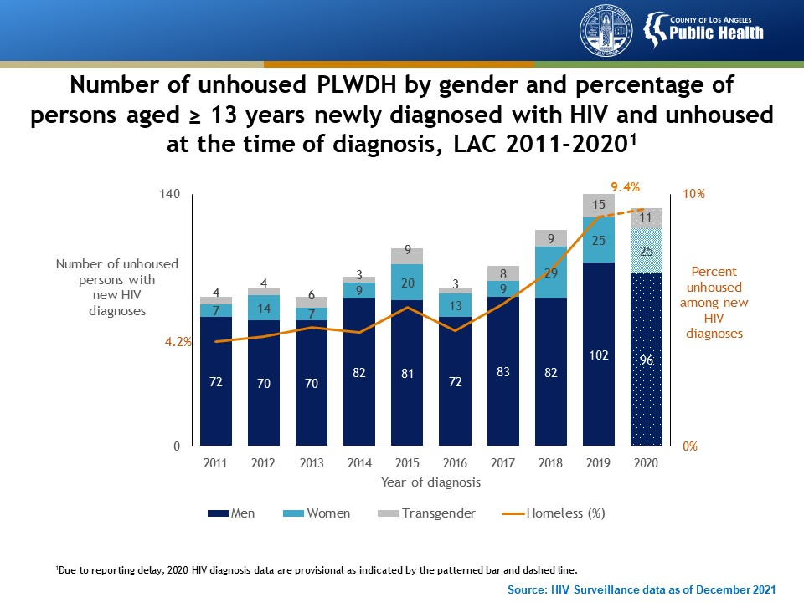
Notes:
This graph presents the number and percentage of persons aged ≥13 years newly diagnosed with HIV who were unhoused at the time of diagnosis by gender in Los Angeles County between 2011 and 2020. Since 2011, the percentage of persons newly diagnosed with HIV who were unhoused increased from 4.2% to 9.4%. In 2020, among 132 unhoused persons with a new HIV diagnosis, 96 (73%) were men, 25 (19%) were women, and 11 (8%) were transgender.
Due to reporting delay, 2020 HIV diagnosis data are provisional as indicated by the patterned bar and dashed line.

Slide 47
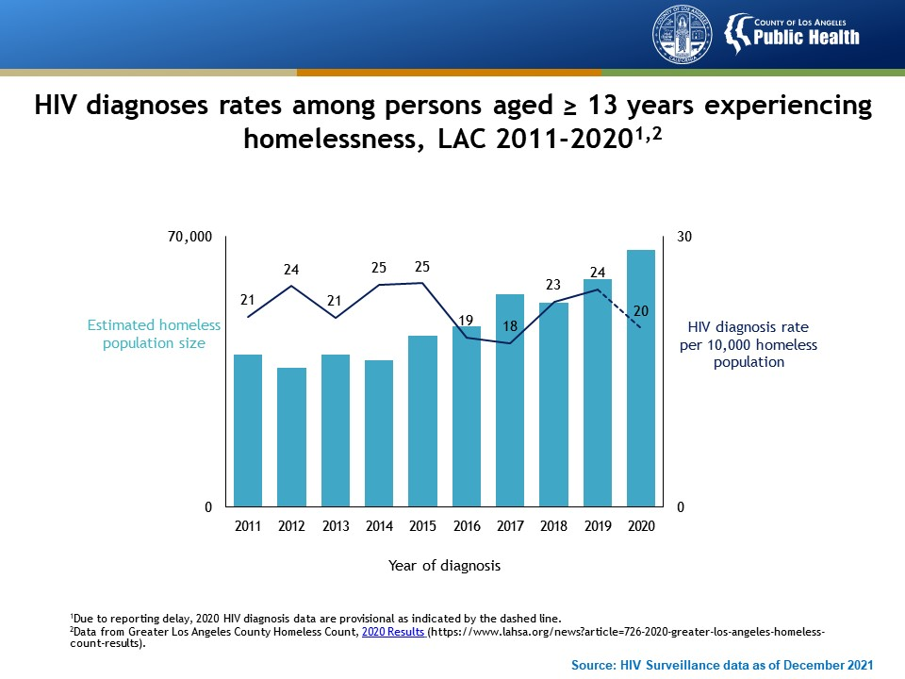
Notes:
This graph presents HIV diagnoses rates among persons aged ≥13 years experiencing homelessness in Los Angeles County between 2011 and 2020. Relatively stable HIV diagnoses rates among unhoused persons indicates that the increase in the unhoused population in Los Angeles County likely explains the increases in HIV diagnoses among unhoused PLWDH.
Due to reporting delay, 2020 HIV diagnosis data are provisional as indicated by the dashed line.
Homeless population data are from Greater Los Angeles County Homeless Count, 2020 Results (https://www.lahsa.org/news?article=726-2020-greater-los-angeles-homeless-count-results).

Slide 48
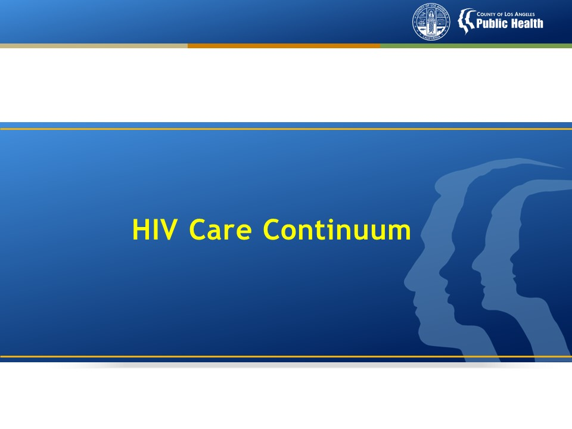

Slide 49
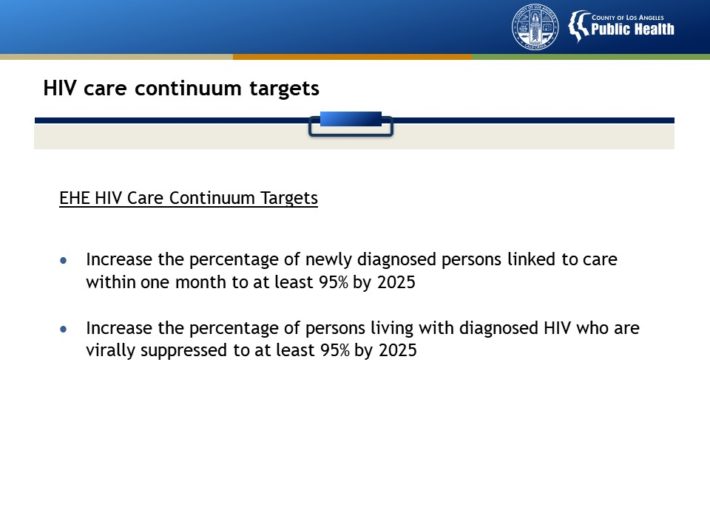

Slide 50
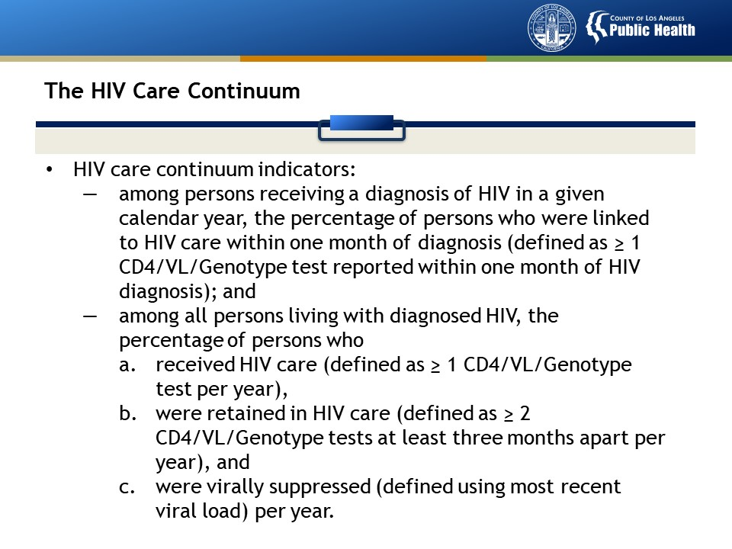

Slide 51


Slide 52

Notes:
This graph presents the HIV care continuum among persons aged ≥13 years in Los Angeles County, 2019-2020 and 2020-2021. Linkage to care within one month of diagnosis remained stable for persons diagnosed with HIV in 2020 compared to persons diagnosed in 2019, as did progress along the subsequent steps in the care cascade in 2021 compared to 2020.
The HIV care continuum includes the following steps in the care cascade: 1) the percentage of persons receiving a diagnosis of HIV in a given calendar year who were linked to HIV care within 1 month of diagnosis (defined as ≥ 1 CD4/VL/Genotype test reported within 1 month of HIV diagnosis) ; and the percentage of all persons living with diagnosed HIV who (1) received HIV care (defined as ≥ 1 CD4/VL/Genotype test per year, (2) were retained in HIV care (defined as ≥ 2 CD4/VL/Genotype tests at least three months apart, per year), and (3) were virally suppressed (defined using most recent viral load, per year). PLWDH without a VL test in the measurement year were categorized as having unsuppressed viral load.
The 2019-2020 HIV care continuum denominator includes persons diagnosed in 2019 to calculate linkage to care ≤ 1 month of diagnosis, and all PLWDH diagnosed through 2019 and living in LAC at year-end 2020 to calculate receipt of care, retention in care, and viral suppression.
The 2020-2021 HIV care continuum denominator includes persons diagnosed in 2020 to calculate linkage to care ≤ 1 month of diagnosis, and all PLWDH diagnosed through 2020 and living in LAC at year-end 2021 to calculate receipt of care, retention in care, and viral suppression.

Slide 53

Notes:
This graph presents the HIV care continuum among children aged <13 years in Los Angeles County, 2019-2020 and 2020-2021. Children aged < 13 years fared better than adolescents and adults at key steps along the continuum of HIV care: 100% of children diagnosed with HIV in 2019 and 2020 were linked to HIV care within 1 month. Receipt of care, retention in care, and viral suppression improved in 2021 compared to 2020.
The HIV care continuum includes the following steps in the care cascade: 1) the percentage of persons receiving a diagnosis of HIV in a given calendar year who were linked to HIV care within 1 month of diagnosis (defined as ≥ 1 CD4/VL/Genotype test reported within 1 month of HIV diagnosis) ; and the percentage of all persons living with diagnosed HIV who (1) received HIV care (defined as ≥ 1 CD4/VL/Genotype test per year, (2) were retained in HIV care (defined as ≥ 2 CD4/VL/Genotype tests at least three months apart, per year), and (3) were virally suppressed (defined using most recent viral load, per year). PLWDH without a VL test in the measurement year were categorized as having unsuppressed viral load.
The 2019-2020 HIV care continuum denominator includes persons diagnosed in 2019 to calculate linkage to care ≤ 1 month of diagnosis, and all PLWDH diagnosed through 2019 and living in LAC at year-end 2020 to calculate receipt of care, retention in care, and viral suppression.
The 2020-2021 HIV care continuum denominator includes persons diagnosed in 2020 to calculate linkage to care ≤ 1 month of diagnosis, and all PLWDH diagnosed through 2020 and living in LAC at year-end 2021 to calculate receipt of care, retention in care, and viral suppression.

Slide 54

Notes:
This graph presents the HIV care continuum among persons aged ≥13 years in Los Angeles County, by housing status at the time of HIV diagnosis, 2020-2021. Unhoused persons had poorer outcomes in the HIV care continuum compared with housed persons, with greatest disparities observed in viral suppression.
Linkage to care: numerator includes persons newly diagnosed with HIV in 2020 with ≥1 CD4/VL/Genotype test reported within 1 month of HIV diagnosis; denominator includes persons who were diagnosed with HIV in 2020.
Receipt of care: numerator includes PLWDH with ≥1 CD4/VL/Genotype test in 2021; denominator includes PLWDH diagnosed through 2020 and living in LAC at year-end 2021 based on most recent residence.
Retention in care: numerator includes PLWDH with ≥2 CD4/VL/Genotype tests at least 3 months apart in 2021; denominator includes PLWDH diagnosed through 2020 and living in LAC at year-end 2021 based on most recent residence.
Viral suppression: numerator includes PLWDH whose last L test in 2021 was suppressed (HIV-1 RNA < 200 copies/mL); denominator includes PLWDH diagnosed through 2020 and living in LAC at year-end 2021 based on most recent residence. PLWDH without a VL test in 2021 were categorized as having unsuppressed viral load.

Slide 55


Slide 56

Notes:
This graph presents time from HIV diagnosis to linkage to care among persons aged ≥13 years in Los Angeles County from 2011 to 2020, by year of HIV diagnosis. Though timeliness of linkage to care has improved over time, only 76% of persons who were newly diagnosed in 2020 were linked to HIV care within one month and only 54% were linked to HIV care within one week.
Data includes persons diagnosed with HIV in each calendar year with ≥1 CD4/VL/Genotype test reported within 1 week, as well as 1, 6, and 12 months of diagnosis.
Due to reporting delay, 2020 HIV linkage to care data are provisional as indicated by the dashed line.

Slide 57

Notes:
This graph presents persons linked to care within 1 month of HIV diagnosis among those aged ≥13 years newly diagnosed with HIV in Los Angeles County in 2020, by selected demographic and risk characteristics. Among persons newly diagnosed with HIV in 2020, groups that were least likely to be linked to HIV care within 1 month of diagnosis were women (67%), Blacks and those whose race/ethnicity was classified as ‘Other’ (71%), persons aged 13-19 years (63%), and persons with heterosexual (66%) and MSM/IDU (67%) transmission risk.
Linked to care: numerator includes persons newly diagnosed with HIV in 2020 with ≥1 CD4/VL/Genotype test reported within 1 month of HIV diagnosis; denominator includes persons who were diagnosed with HIV in 2020.
Other race/ethnicity includes American Indian, Alaska Native, Native Hawaiian and Pacific Islander, persons of multiple race/ethnicities, and persons with unknown race/ethnicity.
Other risk includes risk factor not reported/identified.

Slide 58

Notes:
This graph presents the persons aged ≥13 years newly diagnosed with HIV in 2020 and the percent linked to care within 1 month in Los Angeles County by Health District. None of the Health Districts have met the EHE target for timely linkage to HIV care (at least 95% linked to care within one month) highlighting that the need to identify solutions for improving linkage to care spans across LAC. Lowest achievement in linkages was observed in Alhambra Health District where only 62% of cases were linked within one month of HIV diagnosis.
Linked to care: numerator includes persons newly diagnosed with HIV in 2020 with CD4/VL/Genotype test reported within 1 month of HIV diagnosis; denominator includes persons who were diagnosed with HIV in 2020.
Health Districts are based on 2012 boundaries.

Slide 59


Slide 60

Notes:
This graph presents receipt of care, retention in care, and viral suppression by gender among PLWDH aged ≥13 years diagnosed through 2020 and living in LAC at year-end 2021. The percentage of PLWDH who were receiving HIV care and retained in care in 2021 were similar across gender groups, while the percentage who were virally suppressed in 2021 was slightly lower among transgender persons.
Receipt of care: numerator includes PLWDH with ≥1 CD4/VL/Genotype test in 2021; denominator includes PLWDH diagnosed through 2020 and living in LAC at year-end 2021 based on most recent residence.
Retention in care: numerator includes PLWDH with ≥2 CD4/VL/Genotype tests at least 3 months apart in 2021; denominator includes PLWDH diagnosed through 2020 and living in LAC at year-end 2021 based on most recent residence.
Viral suppression: numerator includes PLWDH whose last VL test in 2021 was suppressed (HIV-1 RNA < 200 copies/mL); denominator includes PLWDH diagnosed through 2020 and living in LAC at year-end 2021 based on most recent residence. PLWDH without a VL test in 2021 were categorized as having unsuppressed viral load.

Slide 61

Notes:
This graph presents receipt of care, retention in care, and viral suppression by age group among PLWDH aged ≥13 years diagnosed through 2020 and living in LAC at year-end 2021. Adolescents had better HIV care outcomes than their counterparts in 2021, while persons aged 30-49 years had the poorest outcomes across the care cascade.
Receipt of care: numerator includes PLWDH with ≥1 CD4/VL/Genotype test in 2021; denominator includes PLWDH diagnosed through 2020 and living in LAC at year-end 2021 based on most recent residence.
Retention in care: numerator includes PLWDH with ≥2 CD4/VL/Genotype tests at least 3 months apart in 2021; denominator includes PLWDH diagnosed through 2020 and living in LAC at year-end 2021 based on most recent residence.
Viral suppression: numerator includes PLWDH whose last VL test in 2021 was suppressed (HIV-1 RNA < 200 copies/mL); denominator includes PLWDH diagnosed through 2020 and living in LAC at year-end 2021 based on most recent residence. PLWDH without a VL test in 2021 were categorized as having unsuppressed viral load.

Slide 62

Notes:
This graph presents receipt of HIV care, retention in HIV care, and viral suppression by race/ethnicity among PLWDH aged ≥13 years diagnosed through 2020 and living in LAC at year-end 2021. Across the continuum, Blacks had the worst HIV care outcomes compared with other groups.
Other race/ethnicity includes American Indian, Alaska Native, Native Hawaiian and Pacific Islander, persons of multiple race/ethnicities, and persons with unknown race/ethnicity.
Receipt of care: numerator includes PLWDH with ≥1 CD4/VL/Genotype test in 2021; denominator includes PLWDH diagnosed through 2020 and living in LAC at year-end 2021 based on most recent residence.
Retention in care: numerator includes PLWDH with ≥2 CD4/VL/Genotype tests at least 3 months apart in 2021; denominator includes PLWDH diagnosed through 2020 and living in LAC at year-end 2021 based on most recent residence.
Viral suppression: numerator includes PLWDH whose last VL test in 2021 was suppressed (HIV-1 RNA < 200 copies/mL); denominator includes PLWDH diagnosed through 2020 and living in LAC at year-end 2021 based on most recent residence. PLWDH without a VL test in 2021 were categorized as having unsuppressed viral load.

Slide 63

Notes:
This graph presents receipt of HIV care, retention in care, and viral suppression by transmission risk category among PLWDH aged ≥13 years diagnosed through 2020 and living in LAC at year-end 2021. Persons whose HIV transmission risk is IDU had the lowest levels of receipt of care, retention in care, and viral suppression.
Receipt of care: numerator includes PLWDH with ≥1 CD4/VL/Genotype test in 2021; denominator includes PLWDH diagnosed through 2020 and living in LAC at year-end 2021 based on most recent residence.
Retention in care: numerator includes PLWDH with ≥2 CD4/VL/Genotype tests at least 3 months apart in 2021; denominator includes PLWDH diagnosed through 2020 and living in LAC at year-end 2021 based on most recent residence.
Viral suppression: numerator includes PLWDH whose last VL test in 2021 was suppressed (HIV-1 RNA < 200 copies/mL); denominator includes PLWDH diagnosed through 2020 and living in LAC at year-end 2021 based on most recent residence. PLWDH without a VL test in 2021 were categorized as having unsuppressed viral load.
Other transmission risk includes perinatal, hemophilia, coagulation disorder, blood transfusion, and risk factor not reported/identified. Persons without an identified risk factor were assigned a risk factor using CDC-recommended multiple imputation methods.

Slide 64

Notes:
This graph presents trends in receipt of care, retention in care, and viral suppression between 2011 and 2021 among PLWDH aged ≥13 years living in LAC at calendar year-end and diagnosed with HIV through the previous calendar year. There has been minimal progress in the HIV continuum of care since 2011, with improvements only seen in the percentage of PLWDH with viral suppression (+6 percentage points). There were declines in percentage of PLWDH receiving care and retained in care after 2019, likely due to the impact of COVID-19 on health care service delivery, which may have delayed further improvements in viral suppression.
Receipt of care: numerator includes PLWDH with ≥1 CD4/VL/Genotype test in the calendar year; denominator includes PLWDH diagnosed through the previous calendar year and living in LAC at calendar year-end based on most recent residence.
Retention in care: numerator includes PLWDH with ≥2 CD4/VL/Genotype tests at least 3 months apart in the calendar year; denominator includes PLWDH diagnosed through the previous calendar year and living in LAC at calendar year-end based on most recent residence.
Viral suppression: numerator includes PLWDH whose last VL test in the calendar year was suppressed (HIV-1 RNA<200 copies/mL); denominator includes PLWDH diagnosed through the previous calendar year and living in LAC at calendar year-end based on most recent residence. PLWDH without a VL test in the calendar year were categorized as having unsuppressed viral load.
Due to reporting delay, 2021 HIV data are provisional as indicated by the dashed line.

Slide 65


Slide 66

Source: HIV Surveillance data as of December 2021
Notes:
This graph presents the time from diagnosis to viral suppression among persons aged ≥ 13 years living with diagnosed HIV in Los Angeles County from 2011 through 2020, by year of HIV diagnosis. Though time from HIV diagnosis to viral suppression has improved over time, LAC is still underperforming in this area, with only 51% of persons newly diagnosed with HIV in 2020 achieving viral suppression within three months.
Analysis includes persons newly diagnosed with HIV in each calendar year and living in LAC at year-end 2020 with or without VL testing. Numerator includes persons who achieved viral suppression within 3, 6, or 12 months of diagnosis. Denominator includes persons newly diagnosed with HIV in select calendar year, with or without a viral load test result in the observed months.
Due to reporting delay, 2020 HIV data are provisional as indicated by the dashed line.

Slide 67

Notes:
This graph presents suppressed viral load by selected demographic and risk characteristics among persons aged ≥ 13 years diagnosed through 2020 and living in LAC at year-end 2021. LAC is not within the target for viral suppression for PLWDH. In 2021, the largest disparities were observed among transgender persons, Blacks, persons aged 30-49 years, and persons with IDU transmission risk.
Suppressed viral load: numerator includes PLWDH whose last VL test in 2021 was suppressed (HIV-1 RNA < 200 copies/mL); denominator includes PLWDH diagnosed through 2020 and living in LAC at year-end 2021 based on most recent residence. PLWDH without a VL test in 2021 were categorized as having unsuppressed viral load.
Other race/ethnicity includes American Indians and Alaska Natives, Native Hawaiian and Pacific Islander, persons of multiple race/ethnicities, and persons with unknown race/ethnicity.

Slide 68

Notes:
This graph presents the number of persons aged ≥ 13 years diagnosed with HIV through 2020 and living in LAC at year-end 2021 and the percent with suppressed viral load, by LAC Health District. Suppressed viral load varies widely across LAC Health Districts. In 2021, no Health District achieved the EHE target for viral suppression (95% or higher with suppressed viral load). In the Central Health District less than half (49%) of PLWDH were virally suppressed and in the South and Southeast Health Districts, less than 60% of PLWDH were virally suppressed. These Health Districts are noted as high risk locations where higher levels of transmission may be occurring.
Suppressed viral load: numerator includes PLWDH whose last VL test in 2021 was suppressed (HIV-1 RNA < 200 copies/mL); denominator includes PLWDH diagnosed through 2020 and living in LAC at year-end 2021 based on most recent residence. PLWDH without a VL test in 2021 were categorized as having unsuppressed viral load.
Health Districts are based on 2012 boundaries.

Slide 69

Notes:
This graph presents suppressed viral load among persons aged ≥ 13 years who had any viral load test in 2021, by LAC Health District. Once in care, the goal is for all PLWDH to achieve viral suppression as soon as possible. In the majority of Health Districts at least 90% of PLWDH in care, with at least one viral load test in 2021, were suppressed. However, in the South, Southeast, Central, Compton, and Southwest Health Districts, less than 90% of PLWDH were virally suppressed.
Suppressed viral load: numerator includes PLWDH whose last VL test in 2021 was suppressed (HIV-1 RNA <200 copies/mL); denominator includes PLWDH diagnosed through 2020 and living in LAC at year-end 2021 based on most recent residence who had any viral load test in 2021. PLWDH without a VL test in 2021 were categorized as having unsuppressed viral load.
Health Districts are based on 2012 boundaries.

Slide 70

Notes:
This map presents unsuppressed viral load among those aged ≥ 13 years diagnosed with HIV through 2019 and living in Los Angeles County at year-end 2020, by census tract. Census tracts located in Central and Hollywood-Wilshire Health Districts had the highest levels of unsuppressed viral load. These are locations where a robust public health response is needed to identify networks of ongoing transmission and deploy rapid interventions to minimize transmission. Other emerging hotspots of transmission that require close monitoring are in Southwest, Southeast, South, and Long Beach Health Districts. We have zoomed in on the six HDs with the highest levels of unsuppressed VL in the maps to the left.
Unsuppressed viral load: numerator includes PLWDH whose last VL test in 2021 was unsuppressed (HIV-1 RNA ≥ 200 copies/mL); denominator includes PLWDH diagnosed through 2020 and living in LAC at year-end 2021 based on most recent residence. PLWDH without a VL test in 2021 were considered virally unsuppressed. Analysis excludes PLWDH diagnosed through 2020 and living at year-end 2021 who (1) had missing census tract information, (2) were receiving care but never had a viral load test, (3) were not receiving care for >12 months at year-end 2021, or (4) were in census tracts with small sample sizes (<5 persons with unsuppressed viral load or population size <100 persons). Exclusions represented 68% of PLWDH diagnosed through 2020 and living in 2021 whose last viral load was unsuppressed.

Slide 71

Notes:
This table presents viral load dynamics among persons aged ≥ 13 years living with diagnosed HIV and receiving HIV care in Los Angeles County between 2019 and 2021. Using the last viral load test, 85% of PLWDH in HIV care were virally suppressed. However, using the results of all viral load tests in a 3-year period, only 74% had sustained viral suppression (i.e., all viral loads suppressed). Populations with the lowest levels of sustained viral suppression were transgender persons, Blacks, American Indians and Alaska Natives (AIAN), and persons aged 20-39 years.
Analysis includes persons diagnosed with HIV through 2018 who had ≥ 1 viral load test in 2019-2021 and were living in LAC during 2019-2021.

Slide 72


Slide 73

Notes:
This figure shows Percentage of persons newly diagnosed with HIV aged ≥ 13 years who had syphilis, gonorrhea, and/or chlamydia in the same calendar year as HIV diagnosis, LAC (excluding Long Beach and Pasadena) from 2011 to 2020. The percentage of persons newly diagnosed with HIV who had one or more STDs in the same year nearly doubled from 22% in 2011 to 43% in 2020. This increasing trend reflects the rise in total STD cases over the same period.

Slide 74

Notes:
This figure shows Percentage of persons newly diagnosed with HIV aged ≥ 13 years who had syphilis, gonorrhea, and/or chlamydia in the same calendar year as HIV diagnosis by STD, LAC (excluding Long Beach and Pasadena) from 2011 to 2020. Co-infections for all three STDs showed similar increasing trends from 2011 to 2020. In 2020, syphilis among newly diagnosed HIV cases was the highest at 23%, followed closely by gonorrhea at 22%. This reflects a rapid rise in the total number of syphilis cases in LAC over the same period.

Slide 75

Notes:
This figure shows percentage of persons newly diagnosed with HIV aged ≥ 13 years who had syphilis, gonorrhea, and/or chlamydia in the same calendar year as HIV diagnosis by STD, gender, and age group, LAC (excluding Long Beach and Pasadena) in 2020. In 2020, percentages of syphilis, gonorrhea, and/or chlamydia co-infections among PLWDH were highest in the transgender population. Among both women and men living with diagnosed HIV, syphilis co-infection was higher than co-infection with other STDs. By age group, syphilis co-infection was highest among PLWDH aged 30 years or older, while co-infection with gonorrhea was highest among PLWDH aged 13-29 years.

Slide 76


Slide 77


Slide 78

Notes:
This table shows COVID-19 and HIV coinfection among PLWDH aged ≥ 13 years in Los Angeles County (excluding Long Beach and Pasadena) from January 2021 to March 2022. Rates of COVID-19 and HIV co-infection among PLWDH were highest among females, persons aged 18 to 29 years, Latinx persons, residents of SPA 8 (South Bay), persons with MSM/IDU transmission risk, persons with suppressed HIV viral load (i.e., proxy for persons on HIV treatment), and unhoused persons.

Slide 79

Notes:
This table shows COVID-19 and HIV coinfection among PLWDH aged ≥ 13 years in Los Angeles County (excluding Long Beach and Pasadena) from January 2021 to March 2022. Rates of COVID-19 and HIV co-infection among PLWDH were highest among females, persons aged 18 to 29 years, Latinx persons, residents of SPA 8 (South Bay), persons with MSM/IDU transmission risk, persons with suppressed HIV viral load (i.e., proxy for persons on HIV treatment), and unhoused persons.

Slide 80

Notes:
This figure shows COVID-19 clinical characters among COVID-19 patients aged ≥ 13 years in Los Angeles County from January 2021 to March 2022. Regardless of vaccination status, patients with HIV and COVID-19 co-infection had higher levels of severe illness, including hospitalization, intensive care unit admission, intubation, and death compared with all COVID-19 patients. Vaccination for COVID-19 reduced the risk of severe outcomes for both HIV and COVID-19 co-infection patients and COVID-19 patients.

Slide 81

Notes:
This table shows COVID-19 deaths among PLWDH and HIV co-infection aged ≥ 13 years, LAC (excluding Long Beach and Pasadena) from January 2021 to March 2022. Mortality rates for persons with HIV and COVID-19 co-infection were highest among transgender persons, persons aged 80 years and older, Black and Latinx persons, residents of SPA 1, and persons with IDU transmission risk. Overall, deaths among persons with HIV and COVID-19 co-infection were similar to the expected number of all deaths for PLWDH. However, deaths among certain groups (persons aged 50 years and older and Latinx) were higher than expected.

Slide 82

Notes:
This table shows COVID-19 deaths among PLWDH and HIV co-infection aged ≥ 13 years, LAC (excluding Long Beach and Pasadena) from January 2021 to March 2022. Mortality rates for persons with HIV and COVID-19 co-infection were highest among transgender persons, persons aged 80 years and older, Black and Latinx persons, residents of SPA 1, and persons with IDU transmission risk. Overall, deaths among persons with HIV and COVID-19 co-infection were similar to the expected number of all deaths for PLWDH. However, deaths among certain groups (persons aged 50 years and older and Latinx) were higher than expected.

Slide 83


Slide 84

Notes:
This graph presents the percentage of persons newly diagnosed with HIV aged ≥ 13 years assigned to partner services, interviewed, named contacts, and linkage to care within 1 month in Los Angeles County (excluding Long Beach and Pasadena) from 2015 through 2020. In 2020, 65% of newly diagnosed HIV-positive persons in LAC were assigned for a Partner Services interview, 40% were interviewed and 9% provided contact information of sexual and/or needle sharing partners. Those assigned but not interviewed were largely due to refusal by the client or inability to locate the client.

Slide 85

Notes:
This graph presents time from HIV diagnosis to HIV Partner Services assignment and interview, LAC (excluding Long Beach and Pasadena) in 2020. In 2020, 10% of HIV PS interviews were within 7 days of HIV diagnosis, 40% within 30 days, and 67% within 60 days. This delay in interview is driven primarily by the time from HIV diagnosis to case assignment for Partner Services (due to delays in case reporting to HIV surveillance).

Slide 86

²
³
Notes:
This graph presents HIV partner services continuum among named contacts, LAC, (excluding Long Beach and Pasadena) in 2020. In 2020, 182 named contacts of persons newly diagnosed with HIV were elicited. Most contacts were located (89%). Of those located, many tested HIV positive (43%), followed by HIV negative (32%) and unknown status (25%). Of contacts who tested HIV positive, most were previously diagnosed as HIV positive (65%). Of those newly diagnosed with HIV, 79% were linked to care. Of contacts with unknown testing status, the majority refused testing (73%).

Slide 87


Slide 88

Notes:
This graph presents time from HIV diagnosis to treatment initiation among persons aged ≥ 13 years newly diagnosed with HIV by year of diagnosis in Los Angeles County from 2011 through 2020. The time from diagnosis to starting HIV treatment is improving. The percent who started ART within 1 month of diagnosis increased from 20% in 2011 to 74% in 2020. The probability of initiating ART within 3 months of diagnosis increased from 51% in 2011 to 89% in 2020.
Data represent a subset of persons newly diagnosed with HIV and reported in LAC. It includes 5,560 persons newly diagnosed with HIV between 2011 and 2020 for whom ART initiation date is complete and excludes 12,670 persons newly diagnosed with HIV between 2011 and 2020 for whom ART initiation date is incomplete.

Slide 89

Notes:
This table presents antiretroviral therapy (ART) prescription, ART dose adherence, and sustained viral suppression, among adults living with diagnosed HIV, by selected characteristics-Medical Monitoring Project(MMP) in Los Angeles County from 2015 through 2019. In a representative sample of PLWDH, only 79% were on ART and 48% had 100% ART dose adherence in the past 30 days. Among those who said they had been prescribed ART, 100% ART dose adherence in the past 30 days was 54% (data not shown). ART adherence and viral suppression was lower among Black and Latinx PLWDH than White PLWDH.

Slide 90

Notes:
This table presents antiretroviral therapy (ART) adherence and reasons for missing ART doses among persons with diagnosed HIV taking ART-Medical Monitoring Project (MMP) in Los Angeles County from 2015 through 2019. Among persons who missed ART doses in the past 30 days, the majority missed 1-2 days of doses. The top reason cited for missing doses was forgetting to take their medicine.

Slide 91


Slide 92

Notes:
This figure shows the trends in HIV prevalence by NHBS population in Los Angeles County from 2004 through 2019. In the most recent surveillance round, transgender women had the highest HIV prevalence across the 4 surveyed populations. HIV prevalence was also high among MSM. By contrast, HIV prevalence among PWID and HET was low.
“HIV Prevalence” refers to the percentage of participants with a confirmed positive HIV test result among the total number of participants tested in NHBS.
Participants were recruited into NHBS using a probability-based sampling method. MSM were recruited using time location sampling; PWID, HET, and Transgender Women were recruited using respondent driven sampling. MSM and HET were surveyed in all 5 NHBS rounds; PWID were surveyed starting in NHBS Round 2; Transgender women were surveyed starting in NHBS Round 5; Data are not weighted. The purpose of this figure is to provide a detailed summary of surveillance data collected as part of NHBS. Unweighted data provide an efficient and transparent way to do so.

Slide 93

Notes:
This graph presents the awareness of HIV-positive serostatus among participants aged ≥ 18 years living with HIV by NHBS population and race/ethnicity in Los Angeles County from 2017 through 2019. Among survey participants living with HIV, 83% of MSM and 80% of transgender women were aware of their HIV-positive status. Only 63% of PWID were aware of their HIV-positive status, however, the result for PWID may be unstable due to small number and must be interpreted with caution.
National HIV Behavioral Surveillance (NHBS) is a national behavioral surveillance system designed to generate nationally representative estimates of HIV prevalence and behaviors among groups at highest risk for HIV infection. Data presented in this figure are not weighted. The purpose of this figure is to provide a detailed summary of surveillance data collected as part of NHBS. Unweighted data provide an efficient and transparent way to do so.
MSM: Gay, bisexual, and other men who have sex with men; A total of 519 MSM participated in NHBS-MSM in 2017;
PWID: Persons who inject drugs; A total of 511 PWID participated in NHBS-PWID in 2018;
HET: Heterosexually active persons at increased risk for HIV infection; A total of 509 HET participated in NHBS-HET in 2019;
Transgender women (TG): Persons who (1) reported a gender identity of woman or transgender woman, and (2) were assigned male or intersex at birth. A total of 501 transgender women enrolled in NHBS-Trans in 2019.
Awareness of HIV infection among PWID and HET is unstable due to small numbers.
Data on HIV testing in the past 12 months excludes participants diagnosed with HIV >12 months prior to the survey interview.

Slide 94

Notes:
This figure shows the trends in HIV prevalence among NHBS-MSM participants by race/ethnicity in Los Angeles County from 2004 through 2017. Over the course of 5 rounds of NHBS, spanning over a decade, HIV prevalence has consistently been highest among Black MSM. In the most recent surveillance round, 36% of Black MSM were living with HIV compared with 18% of Latinx MSM and 15% of White MSM.
National HIV Behavioral Surveillance (NHBS) is a national behavioral surveillance system designed to generate nationally representative estimates of HIV prevalence and behaviors among groups at highest risk for HIV infection. Data presented in this figure are not weighted. The purpose of this figure is to provide a detailed summary of surveillance data collected as part of NHBS. Unweighted data provide an efficient and transparent way to do so.

Slide 95

Notes:
This figure shows HIV testing behavior, STD diagnosis, and sexual behavior among MSM participants in the National HIV Behavioral Surveillance (NHBS) system by race/ethnicity in Los Angeles County in 2017. In 2017, HIV testing within the previous 12 months was high among MSM of all race/ethnicity groups. Reports of condomless anal sex ranged from 71% among Black MSM to 79% among Latinx MSM.
There were 111 Black MSM, 148 White MSM, and 214 Latinx MSM NHBS participants in the 2017 surveillance round. All sexual behavior indicators reflect behavior in the 12 months prior to the interview. HIV testing in the past 12 months excluded participants who were diagnosed with HIV more than 12 months prior to the interview. STD diagnosis was based on respondents’ self-report of having received at least one STD diagnosis by a health care provider within the 12 months preceding the interview. Condomless anal sex refers to either or both condomless receptive and/or condomless insertive anal sex.

Slide 96

Notes:
This figure shows PrEP and PEP among NHBS-MSM participants by race/ethnicity in Los Angeles County in 2017. In 2017, knowledge of PrEP was high (>92%) among MSM irrespective of race/ethnicity. Among participants who reported HIV-negative or unknown HIV status, 36% of White MSM had used PrEP within the past 12 months compared with 22% of Black MSM and 29% of Latinx MSM. Within the past 12 months, compared with Black and Latinx MSM, White MSM were more likely to have used PrEP consistently for 2 or more continuous months.

Slide 97

Notes:
This figure presents injection drug use behavior and recent sexual behavior among persons who inject drugs (PWID) among National HIV Behavioral Surveillance participants by age group in Los Angeles County in 2018. A higher percentage of PWID aged 18-29 years reported sharing syringes or injection equipment compared with PWID aged >30 years, while the reverse was found among PWID who reported exchanging sex for money or drugs.

Slide 98

Notes:
This figure presents testing and sexual behavior among NHBS heterosexuals at increased risk of HIV (HET) by sex and race/ethnicity in Los Angeles County in 2019. HET women were more likely to have tested for HIV and STD than HET men. Among HET women, Black HET were more likely than Latinx HET to report condomless sex with a casual partner, receiving money or drugs in exchange for sex, and having concurrent sexual partnerships.
136 Black males, 118 Latinx males, 142 Black females, and 98 Latinx females participated in the 2019 NHBS-HET cycle. All sexual behavior indicators reflect sexual behavior with the opposite sex in the 12 months prior to the survey interview. Tested for HIV in the past 12 months excludes participants who reported being diagnosed with HIV more than 12 months prior to the interview. Tested for STD in the past 12 months included respondent’s self-report of being tested for any STD other than HIV and hepatitis by a health care provider within 12 months prior to the interview. A casual partner is a sex partner that the respondent does not feel committed to or does not know very well. Having concurrent partners with last partner is measured by asking participants ”when you were having a sexual relationship with last partner, did you have sex with other people?”

Slide 99

Notes:
This figure presents HIV prevalence, HIV/STD testing behavior, sexual behavior and drug use among NHBS-Transgender Women(TGW) by race/ethnicity in Los Angeles County in 2019. Among TG women, HIV prevalence was highest among Blacks (52%), followed by Latinx (30%), and White (9%). Black TG women were more likely to practice condomless anal sex and exchange sex for drugs or money but less likely to test recently for HIV than their Latinx and White counterparts.
HIV prevalence refers to the percentage of participants with a confirmed positive NHBS HIV test result among the total number of participants tested in NHBS. Tested for HIV in the past 12 months excluded participants who reported being diagnosed with HIV more than 12 months prior to the interview. Tested for STD in the past 12 months included respondent’s self-report of being tested for any STD other than HIV and hepatitis by a health care provider within 12 months prior to the interview. All sexual behavior indicators reflect behavior in the 12 months prior to the interview. Condomless anal sex refers to self-reports of either or both receptive and/or insertive anal sex without a condom. Condomless vaginal sex refers to self-reports of either or both receptive and/or insertive vaginal sex without a condom (vaginal sex refers to penis in the vagina or neovagina). Methamphetamine use includes self-reports of meth, crystal, speed, or crank use in 12 months prior to the interview.
Estimates for White transgender women may be unstable and must be interpreted with cation due to small numbers.

Slide 100

Notes:
This figure shows PrEP cascade among NHBS-Transgender Women (TGW) in Los Angeles County in 2019. The majority (91%) of HIV-negative transgender women had heard of PrEP and a little over half (55%) had discussed PrEP with a healthcare provider. Twenty-seven percent had taken PrEP in the last 12 months and 21% were PrEP persistent.
PrEP persistent is defined as having taken PrEP every day or almost every day for at least 2 months in a row in the past 12 months

Slide 101


